Slide 1


Realizing 5G ORAN with USRP N321: A Software – Defined Radio Approach
Review -3: 19/3/25
GITAM (Deemed-to-be) University
Major Project
Project ID: PROJ3999
AY 2021-25
Department of Electrical Electronics and Communication Engineering
Project Mentor:
Dr. T Nagarjuna
Project In-charge:
Dr. Pankaj Kandhway
Project Team:
BU21EECE0100361 (P. Prudvi reddy )
BU21EECE0100391 (MC. Mokshith )
BU21EECE0100377 (B. Gopal )
www.gitam.edu

Slide 2



Project Group – Details
Photo
Track
Roll No
Name
EECE AI/ML
BU21EECE0100361
P.Prudvi reddy
EECE AI/ML
BU21EECE0100391
MC.Mokshith
EECE AI/ML
BU21EECE0100377
B.Gopal

Slide 3
Objective and Goals
Objective
To design, implement, and evaluate a scalable and reliable 5G private network using the USRP N321, integrating srsRAN 5G, srsRAN 4G, and OAI. This project leverages ZeroMQ for efficient communication, supports both single and multiple UEs, and utilizes Grafana for real-time performance monitoring. The focus is on seamless hardware-protocol integration and rigorous performance analysis to enhance network reliability and efficiency for high-performance applications
Goals
Main Goals
Design and deploy a 5G private network using the USRP N321, integrating srsRAN 5G, srsRAN 4G, and OAI for a scalable and flexible architecture.
Implement ZeroMQ for efficient communication, enabling seamless data exchange between network components.
Support and evaluate single and multiple UEs, ensuring robust connectivity, scalability, and performance.
Utilize Grafana for real-time monitoring, analyzing key performance metrics such as throughput, latency, and reliability.

Slide 4
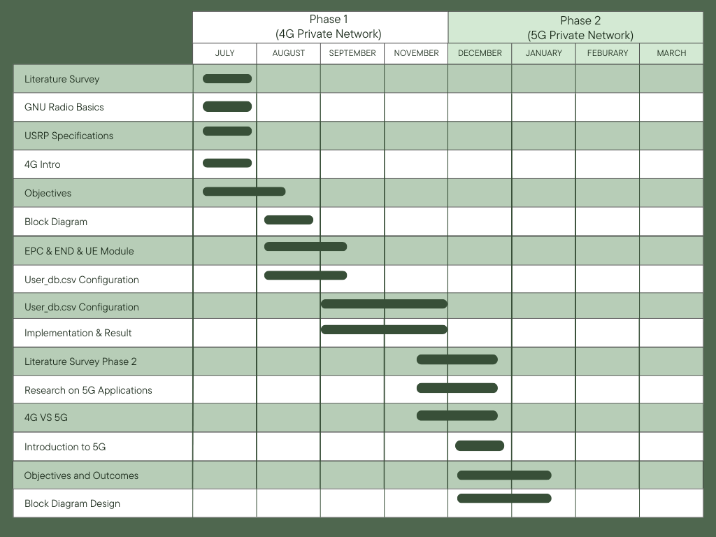
Project Plan
Gant Chart - Milestones and Activities

Slide 5
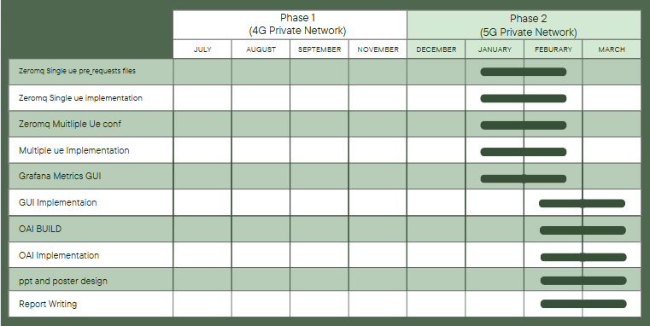
Project Plan
Gant Chart - Milestones and Activities

Slide 6
Literature Survey
Key Publications
Testing Performance for Several Use Cases with an Indoor OpenAirInterface USRP-Based Base Station- Gcina Dludla, Mla Vilakazi, Chris R. Burger, Albert A. Lysko, Lwando Ngcama, Lawrence Mboweni,Moshe Masonta, Hlabi Kobo, Lusani Mamushiane
5G ORAN O-RU Emulator Implemented on the USRP SDR in the FR1 and FR3 Bands - Neel Pandeya, Amr Haj-Omar, Aditya Dhananjay, Michael Zappe
Exploring the Potential of a 5G NSA Network Deployed with Open Source and USRP B210 Equipment - Luis Pesantez Sanchez, Jefferson Ribadeneira Ramírez, Fabricio Santacruz Sulca, David Moreno Avilés
SDR 5G NSA Mobile Network and an IMS Core to provide Voice Over IP LTE service - Jussif J. Abularach Arnez, Wederson Medeiros Silva, Renata K. Gomes Do Reis, Leandro Almeida Da Silva, Maria G. Lima Damasceno
Existing Implementations – Products| Opensource| GitHub etc
https://github.com/open5gs/open5gs
https://github.com/srsRAN/srsRAN_Project
https://github.com/grafana/grafana
https://github.com/EttusResearch/uhd
https://wiki.gnuradio.org/index.php/Tutorials
https://www.ettus.com/all-products/usrp-n321/
6

Slide 7
Literature Survey (Improved post minor project)
Key Publications
S.NO | TITLE | APPLICATION NOTES | DATASHEET
1. | Testing Performance for Several Use Cases with an Indoor OpenAI Interface USRP-Based Base Station | This document outlines the initial implementation of a 5G RAN using Open Air Interface and USRP hardware, focusing on testing for streaming, browsing, and VoIP. | Metrics show 23-27 ms latency and up to 15 Mbps throughput within 15 meters, with challenges beyond 20 meters. Applications include 4K streaming, VoIP, and rural connectivity.
2. | 5G ORAN O-RU Emulator Implemented on the USRP SDR in the FR1 and FR3 Bands | The 5G ORAN O-RU Emulator on USRP X410 enables testing 5G technologies in FR1/FR3 bands, supporting ORAN components and features like beamforming and spectrum sensing. | The Emulator operates in FR1/FR3 bands, supports Split-7.2 architecture, and is ideal for testing advanced wireless technologies with future-ready flexibility.
3. | Exploring the Potential of a 5G NSA Network Deployed with Open Source and USRP B210 Equipment | A 5G NSA network using Open Air Interface and USRP B210 achieved 12 ms latency, 125 Mbps DL, and 7 Mbps UL. It provides a low-cost platform for 5G research and aligns with 3GPP standards. | The 5G NSA setup with USRP B210 supports 2.68 GHz (B7) and 3.619 GHz (N78) bands, achieving 125 Mbps DL and 7 Mbps UL with ~12 ms latency. Ideal for academic 5G experiments.
4. | SDR 5G NSA Mobile Network and an IMS Core to provide Voice Over IP LTE service | The document details integrating a 5G NSA network with IMS for VoLTE, covering architecture, configurations, and performance, focusing on latency, call setup, and voice quality. | Key specs include multi-band support, SIP/RTP, SDR compatibility, QoS features, <2s call setup, <20ms latency, and 99.99% reliability. Applications span enterprise telephony to emergency systems, compliant with 3GPP Release 15 and IP65.

Slide 8
Analysis - SWOT
Strengths
Weaknesses
W1. High deployment cost
W2. Complex setup
W3. Limited range
W4. Regulatory hurdles
S1. High-speed, low-latency
S2. Enhanced capacity
S3. Secure communication
S4. Network slicing
Threats
Opportunities
T1. Rapid technological changes
T2. Security concerns
T3. Competitive pressure
T4. Privacy concerns
O1. Enterprise applications
02. Edge computing integration
O3. Growing IoT market
04. Public-private partnerships
8

Slide 9
Analysis – 4W1H
Why: To create a private 5G network LAN for secure, high-speed, cost-effective, and customizable communication within a specific area or organization, utilizing srsRAN 5G and the USRP N321 for high-performance, flexible wireless communication.
What: srsRAN 5G is an open-source software suite that provides tools and libraries for implementing and managing 5G networks, including base stations (gNB) and core network components (5GC), compatible with SDR hardware like the USRP N321.
Where: It is used globally in research, development, and educational settings, as well as for deploying private 5G networks in specific locations or organizations.
When: srsRAN 5G was initially released in 2016 for 4G LTE, and since then has evolved to support 5G technology, with continuous updates and improvements to accommodate the latest features.
How: Install srsRAN on a Linux system (such as Ubuntu), configure the network components and settings for 5G, connect the USRP N321 to the system, and run the necessary software processes to set up and operate the 5G network.
Refined Objective: To provide a flexible, open-source platform for deploying and experimenting with 5G networks, enabling users to create private 5G networks, conduct research, develop new features, and gain hands-on experience with 5G technologies using software-defined radio (SDR) hardware like the USRP N321
9

Slide 10
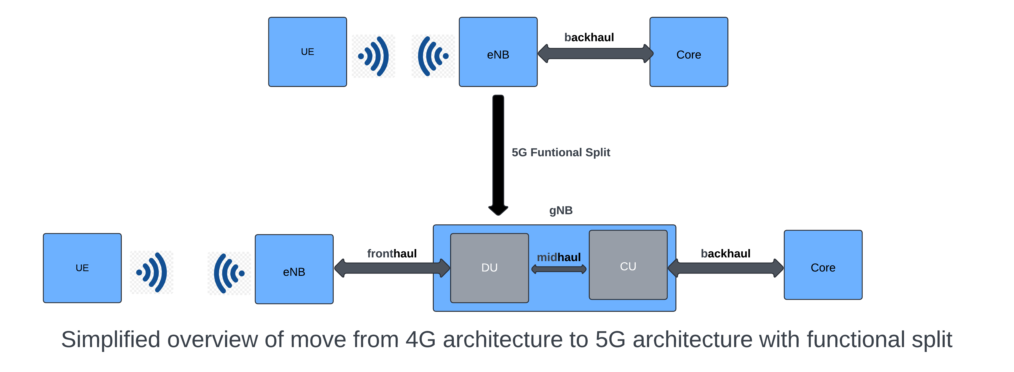
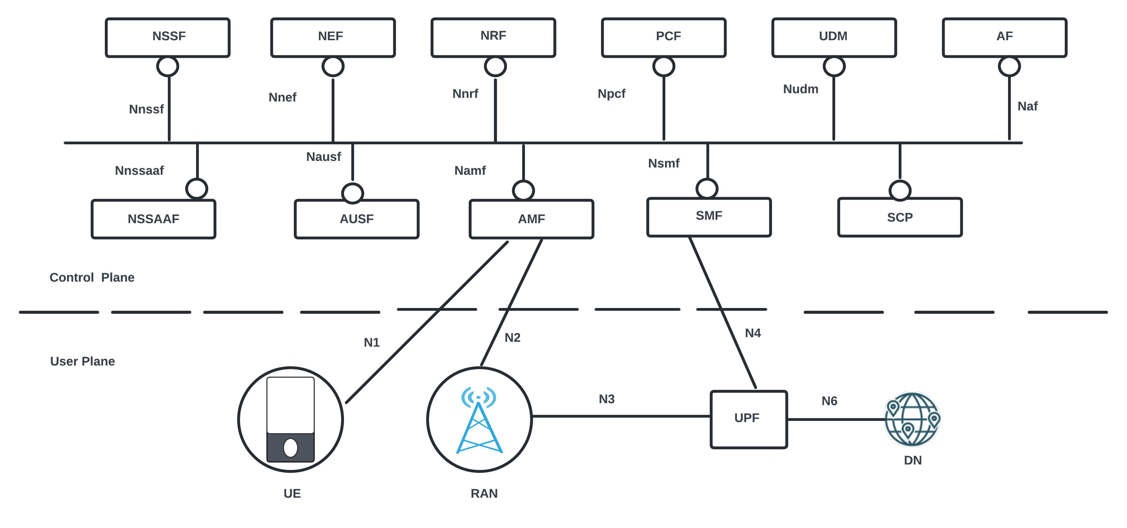
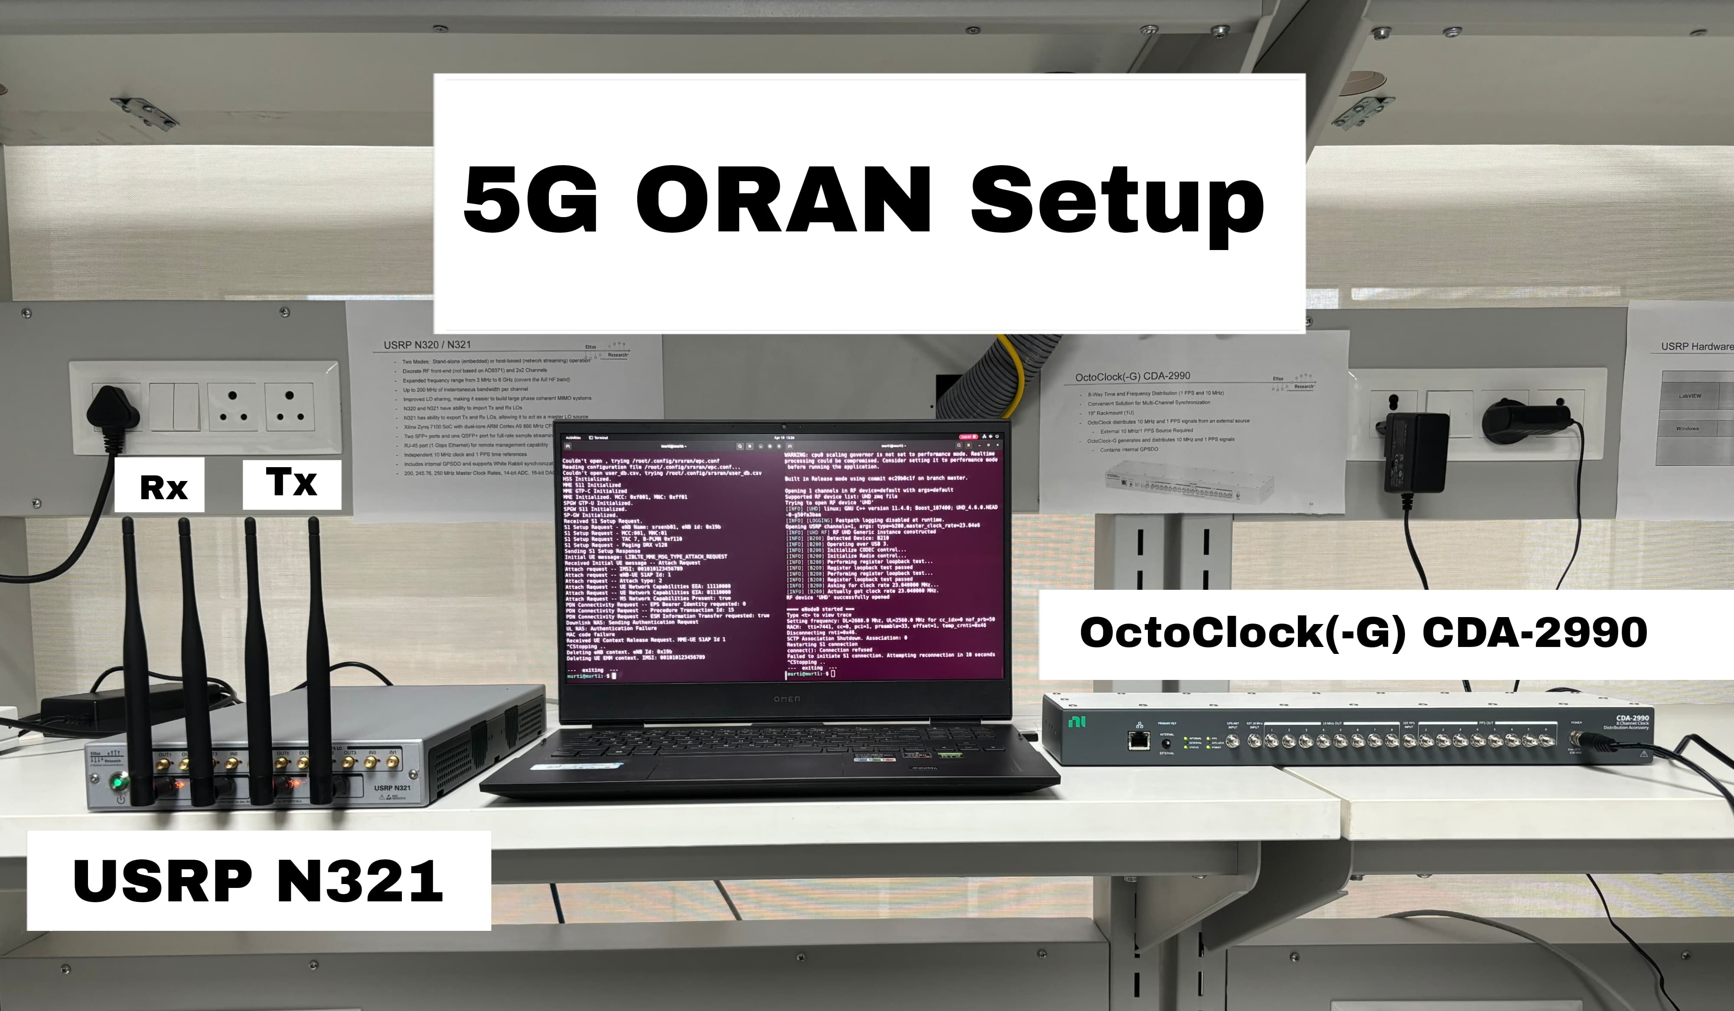
Architecture
Structural Diagram

Slide 11
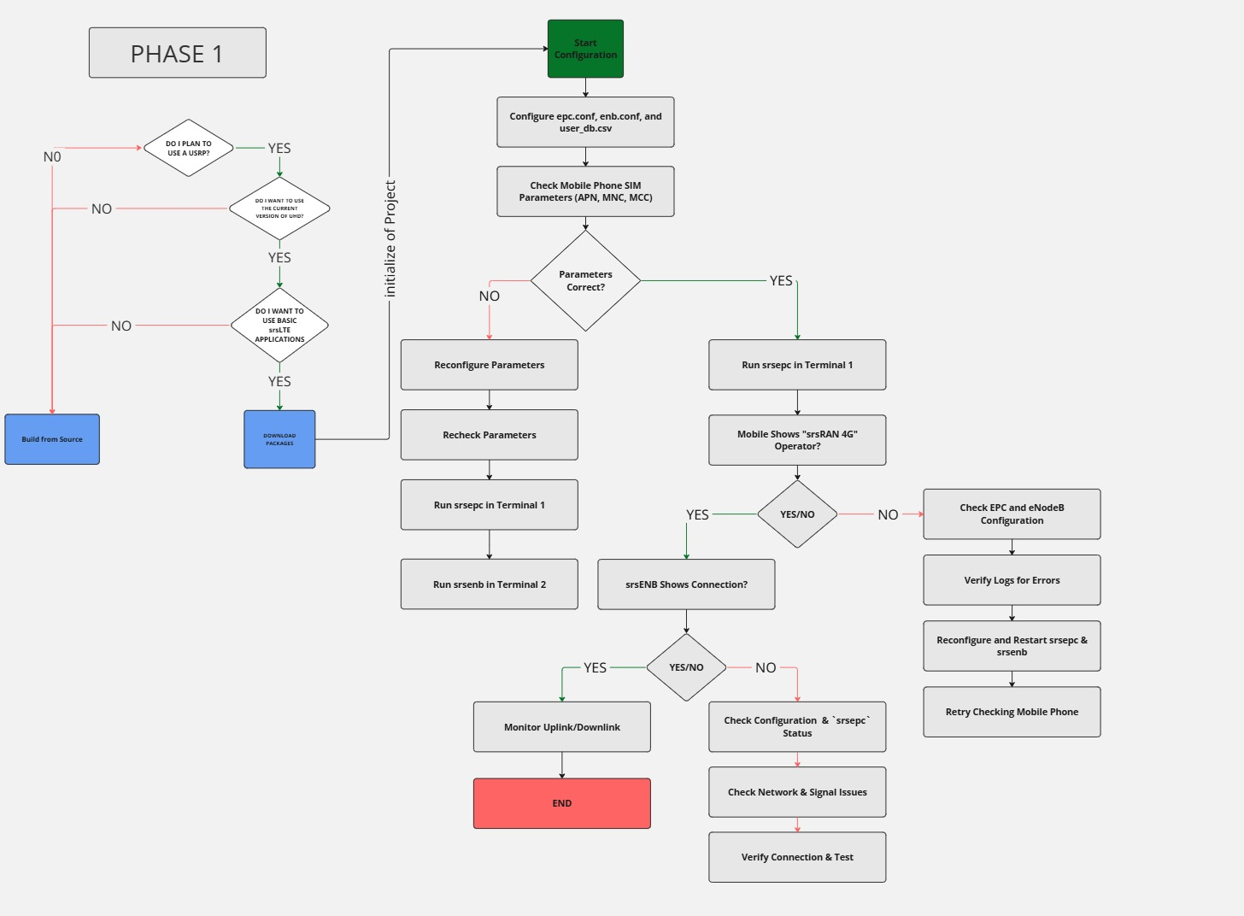
Architecture
Behaviour Diagram
11

Slide 12
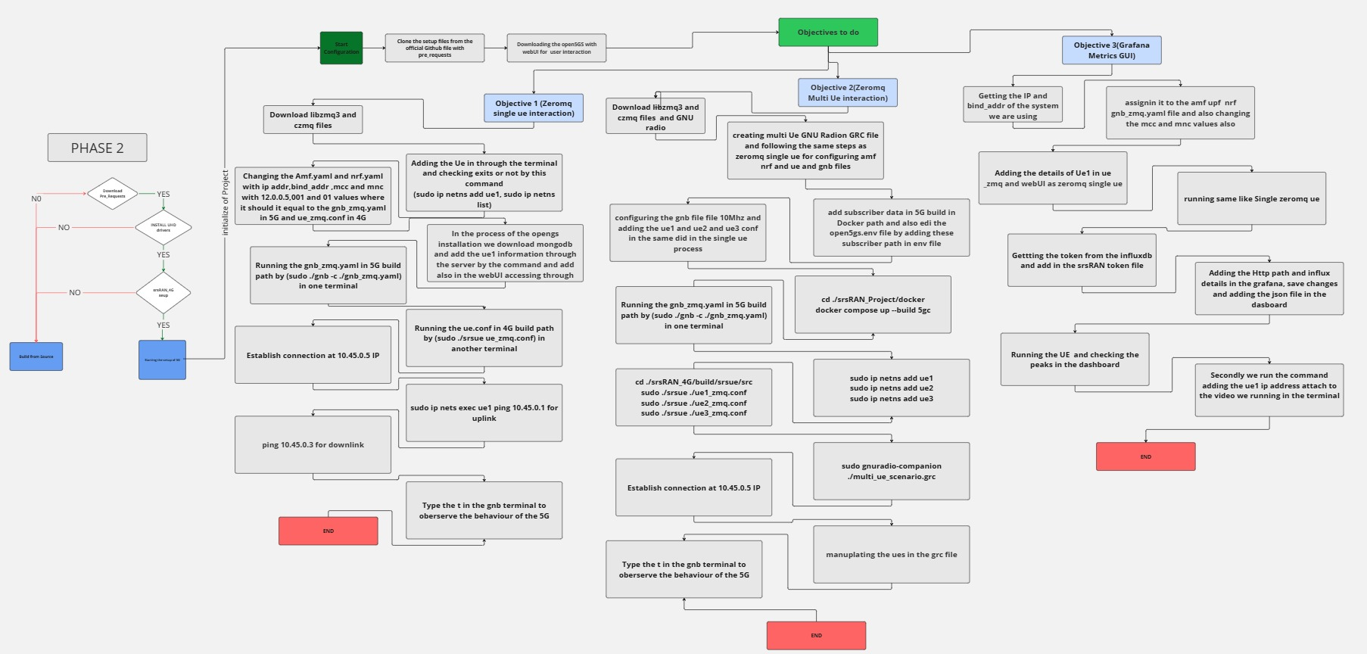
Architecture
Behaviour Diagram
12

Slide 13

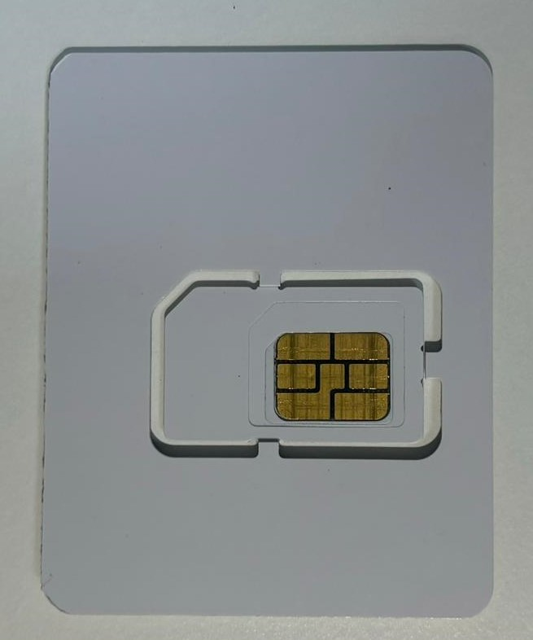
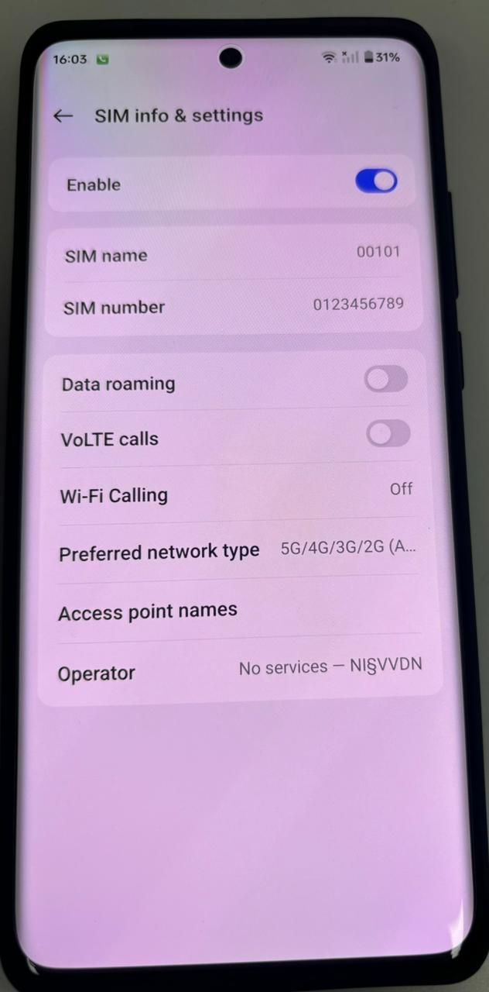
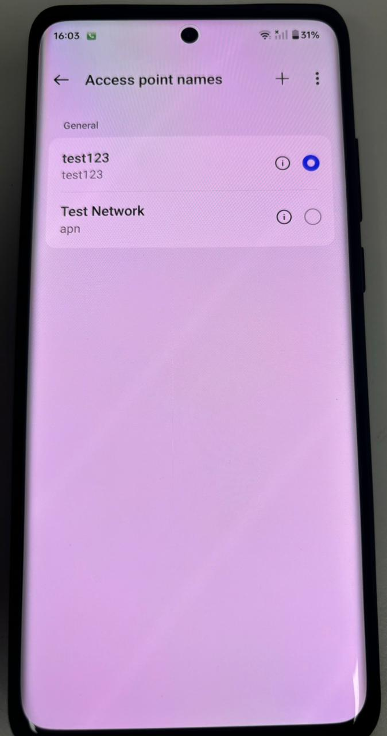
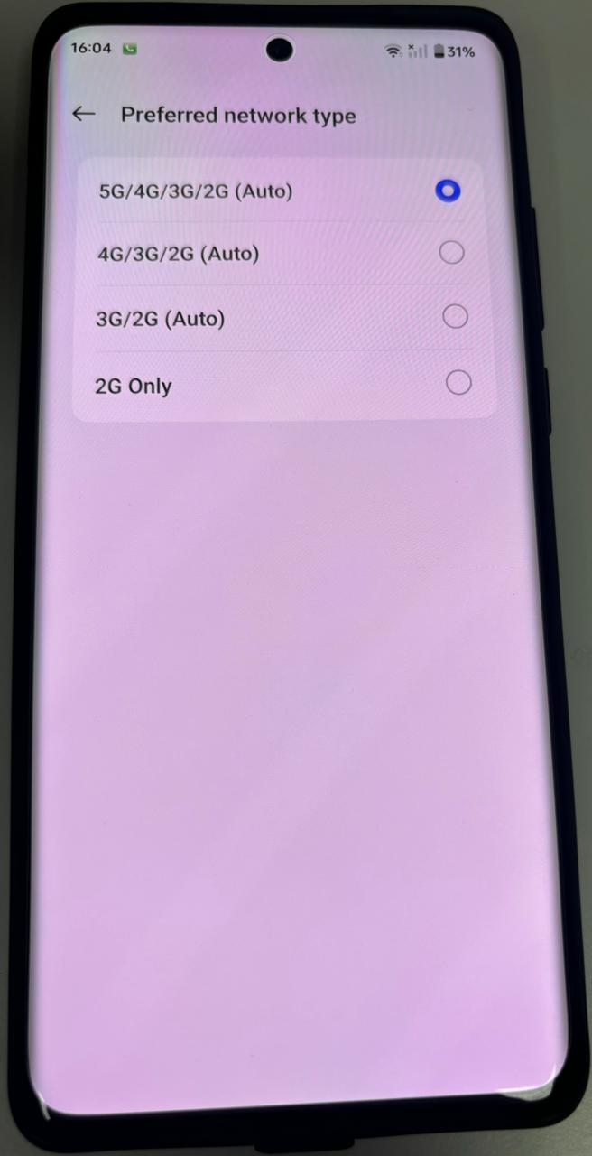
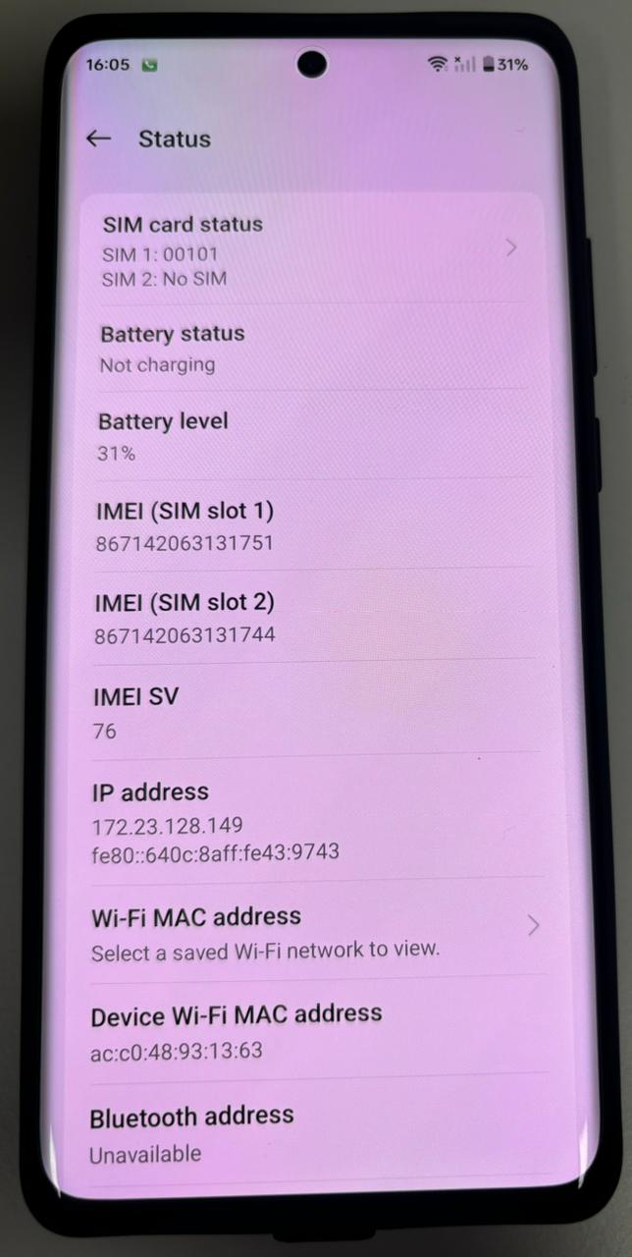
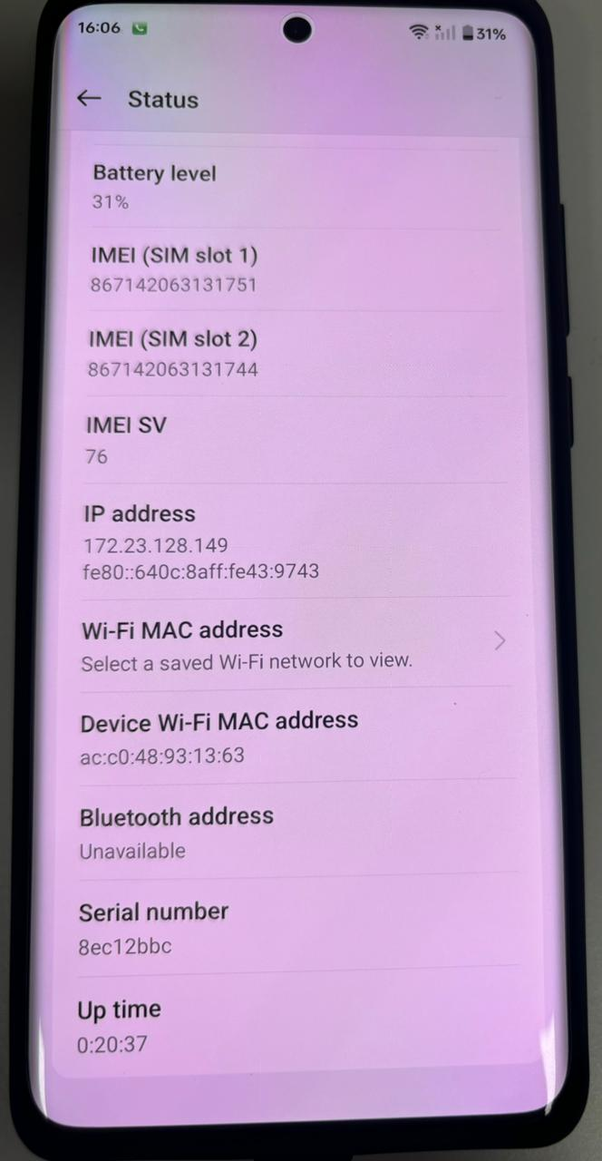
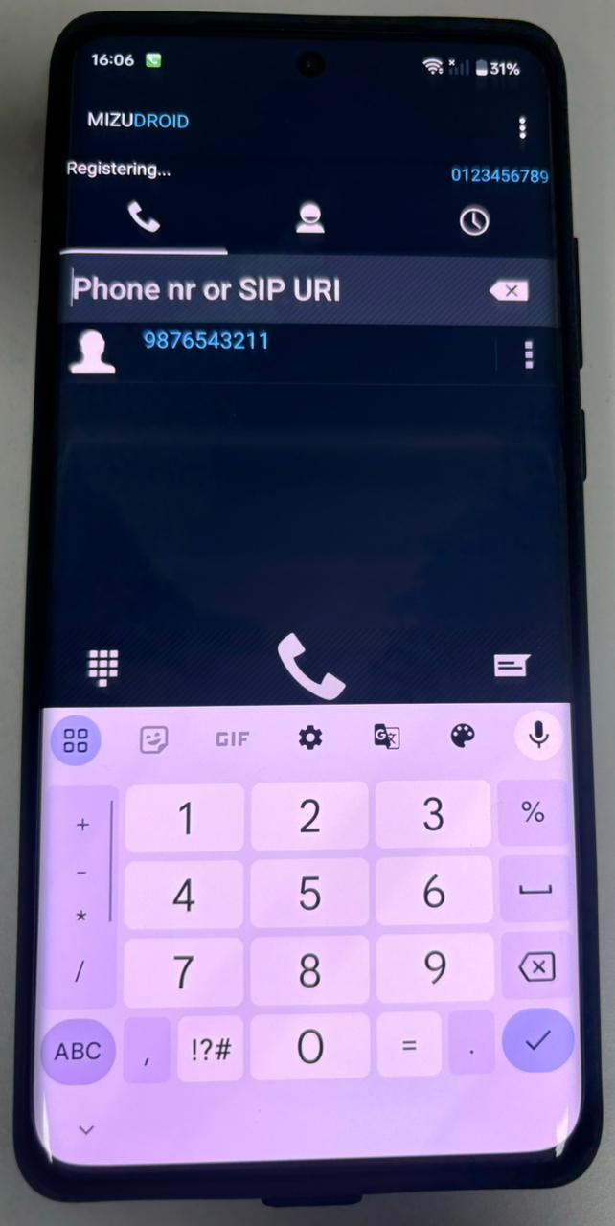
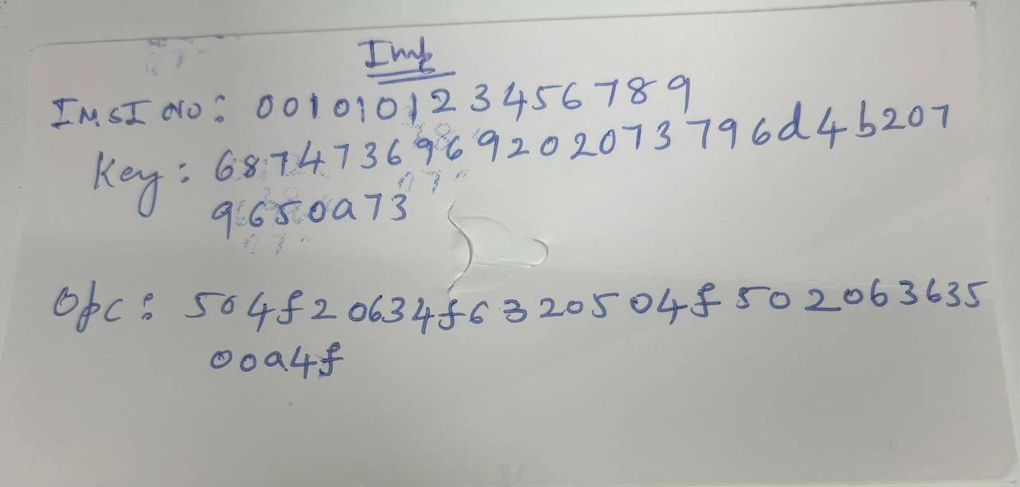
UE(User Equipment)

Slide 14

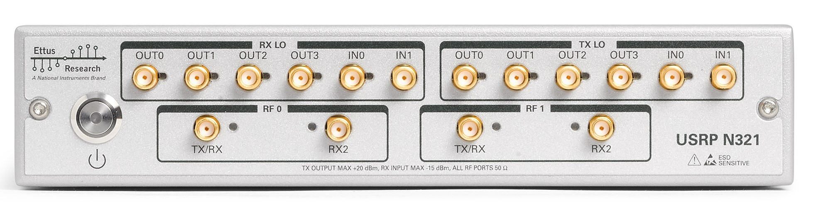
eNB(eNodeB)
Traditional eNB:
eNB Used in the Project:
The USRP N321 acts as an eNodeB by processing LTE signals through a software-defined radio (SDR) architecture. It interfaces with the LTE software stack to handle tasks like modulation, demodulation, and radio resource management. The N321 communicates with user equipment (UE) and the core network, facilitating 4G LTE connectivity
14

Slide 15
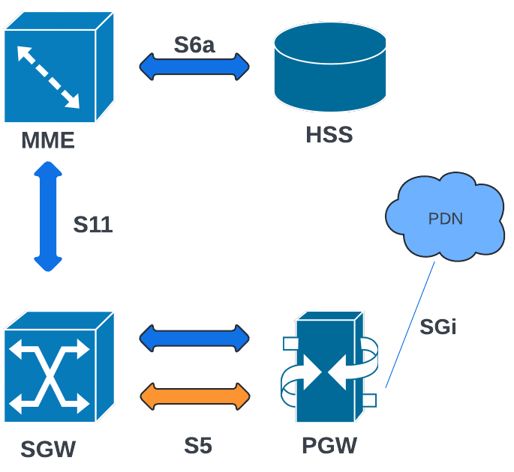
EPC(Evolved Packet Core)
EPC:
Epc Consists of MME, SGW, HSS and PGW
MME(Mobility Management Entity):
The MME manages control plane functions, including user authentication, session management, and handovers between base stations. It connects to the HSS for subscriber data and to the SGW for routing user traffic
HSS(Home Subscriber Server):
The HSS is a centralized database that stores user profiles, authentication data, and mobility information, enabling secure network access and efficient session management by the MME
SGW(Serving Gateway):
The SGW acts as an intermediary between the eNodeB (base station) and the PGW, handling the routing and forwarding of user data packets within the LTE network and managing handovers.
PGW(Packet Data Network Gateway):
The PGW serves as the interface between the LTE network and external packet data networks (e.g., the internet), providing IP address allocation, policy enforcement, and charging data collection
15
15

Slide 16
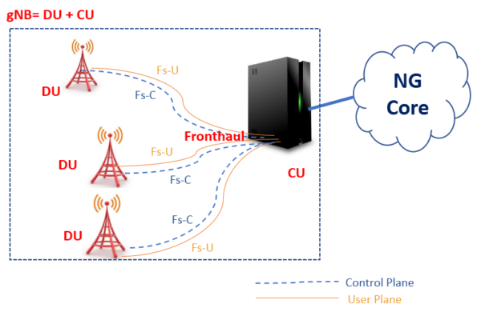
Distributed Unit (DU) in 5G
The Distributed Unit (DU) is responsible for handling real-time processing and lower-layer functions in a 5G network. It processes Layer 1 (Physical Layer - PHY), Layer 2 (Medium Access Control - MAC, Radio Link Control - RLC), and part of Packet Data Convergence Protocol (PDCP).
DU is deployed closer to the radio hardware to minimize latency and optimize performance. It manages radio resource allocation, scheduling, and signal transmission to ensure efficient communication with User Equipment (UEs).
The DU connects to the Central Unit (CU) via the F1 interface, allowing centralized network control while offloading real-time tasks to edge locations. This setup improves responsiveness and supports high-throughput, low-latency applications.

Slide 17
Central Unit (CU) in 5G
The Central Unit (CU) is responsible for higher-layer functions, including Layer 3 (Radio Resource Control - RRC) and the upper part of PDCP. It plays a crucial role in managing mobility, security, and network signaling in 5G.
CU connects to multiple DUs via the F1 interface and interfaces with the 5G Core Network (5GC) via NG interfaces. This centralized architecture allows for better scalability, flexibility, and network optimization.
By separating real-time and non-real-time tasks, the CU enables efficient network slicing, cloud-based deployments, and ultra-reliable low-latency communication (URLLC), making it a key component in modern 5G networks.

Slide 18
Implementation and Results
Objective 1: Zeromq Single UE Implementation
sudo apt-get install build-essential cmake libfftw3-dev libmbedtls-dev libboost-program-options-dev libconfig++-dev libsctp-dev
git clone https://github.com/srsRAN/srsRAN_4G.git
cd srsRAN_4G
mkdir build
cd build
cmake ../
make
make test
sudo make install
srsran_install_configs.sh user sudo apt-get install libzmq3-dev git clone https://github.com/zeromq/libzmq.git
cd libzmq
./autogen.sh
./configure
make
sudo make install
sudo ldconfig
git clone https://github.com/zeromq/czmq.git
cd czmq
./autogen.sh
./configure
make
sudo make install
sudo ldconfig
curl -fsSL https://pgp.mongodb.com/server-6.0.asc | sudo gpg -o /usr/share/keyrings/mongodb-server-6.0.gpg --dearmor
echo "deb [ arch=amd64,arm64 signed-by=/usr/share/keyrings/mongodb-server-6.0.gpg ] https://repo.mongodb.org/apt/ubuntu focal/mongodb-org/6.0 multiverse" | \ sudo tee /etc/apt/sources.list.d/mongodb-org-6.0.list
sudo apt-get update
sudo apt-get install -y mongodb-org
sudo add-apt-repository ppa:open5gs/latest
sudo apt-get update
sudo apt-get install -y open5gs

Slide 19
Implementation and Results
Objective 1: Zeromq Single UE Implementation
sudo apt update
sudo apt install -y ca-certificates curl gnupg
sudo mkdir -p /etc/apt/keyrings
curl -fsSL https://deb.nodesource.com/gpgkey/nodesource-repo.gpg.key | sudo gpg --dearmor -o /etc/apt/keyrings/nodesource.gpg
NODE_MAJOR=20
echo "deb [signed-by=/etc/apt/keyrings/nodesource.gpg] https://deb.nodesource.com/node_$NODE_MAJOR.x nodistro main" | sudo tee /etc/apt/sources.list.d/nodesource.list
sudo apt update
sudo apt install nodejs –y
sudo zypper install nodejs8
curl -fsSL https://open5gs.org/open5gs/assets/webui/install | sudo -E bash
sudo systemctl restart open5gs-amfd
wget https://raw.githubusercontent.com/open5gs/open5gs/main/misc/db/open5gs-dbctl
chmod +x open5gs-dbctl
./open5gs-dbctl add 001010123456780 00112233445566778899aabbccddeeff 63BFA50EE6523365FF14C1F45F88737D
./open5gs-dbctl showpretty
sudo ip netns add ue1
sudo ip netns list
sudo ip ro add 10.45.0.0/16 via 10.53.1.2
route –n
sudo ip netns exec ue1 ping 10.45.1.1
ping 10.45.1.2
Sudo ./gnb –c ./gnb_zmq.yaml
Sudo ./srsue ue_zmq.conf
In gnb type (t) to trace

Slide 20
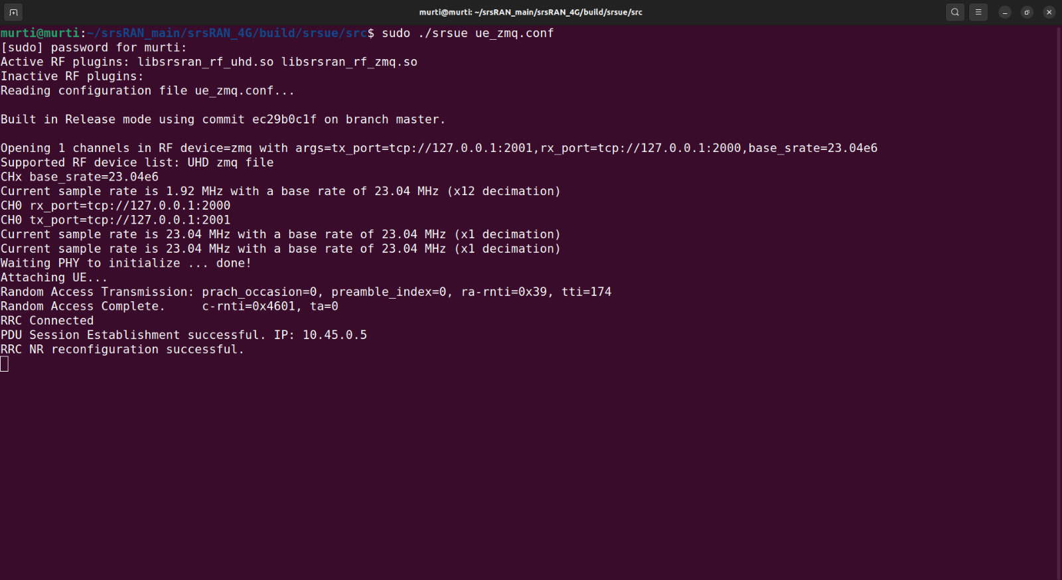
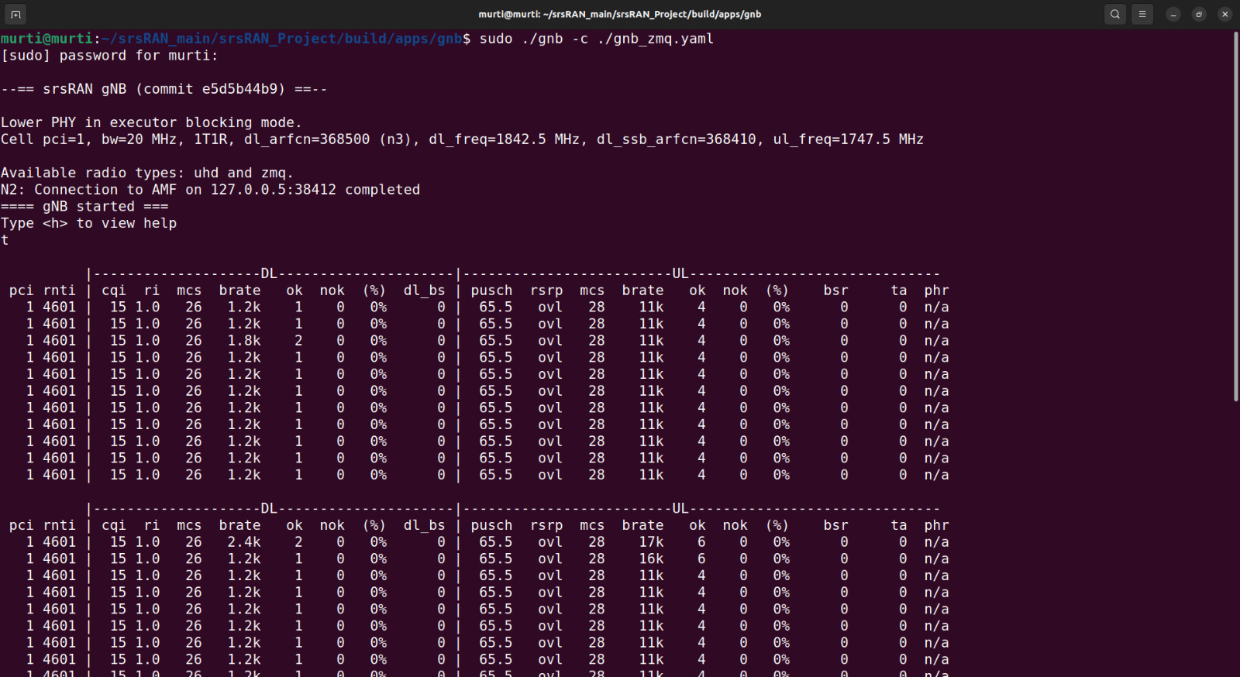
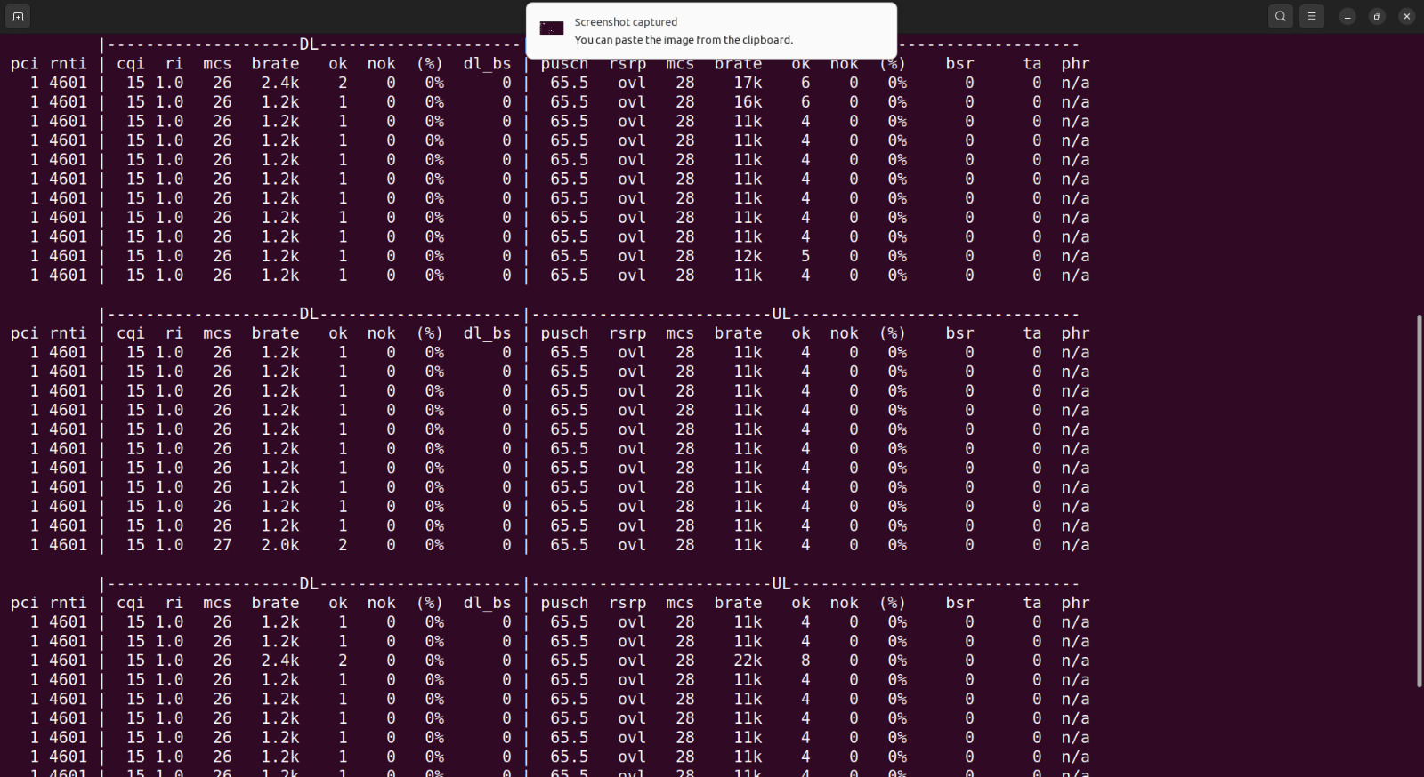
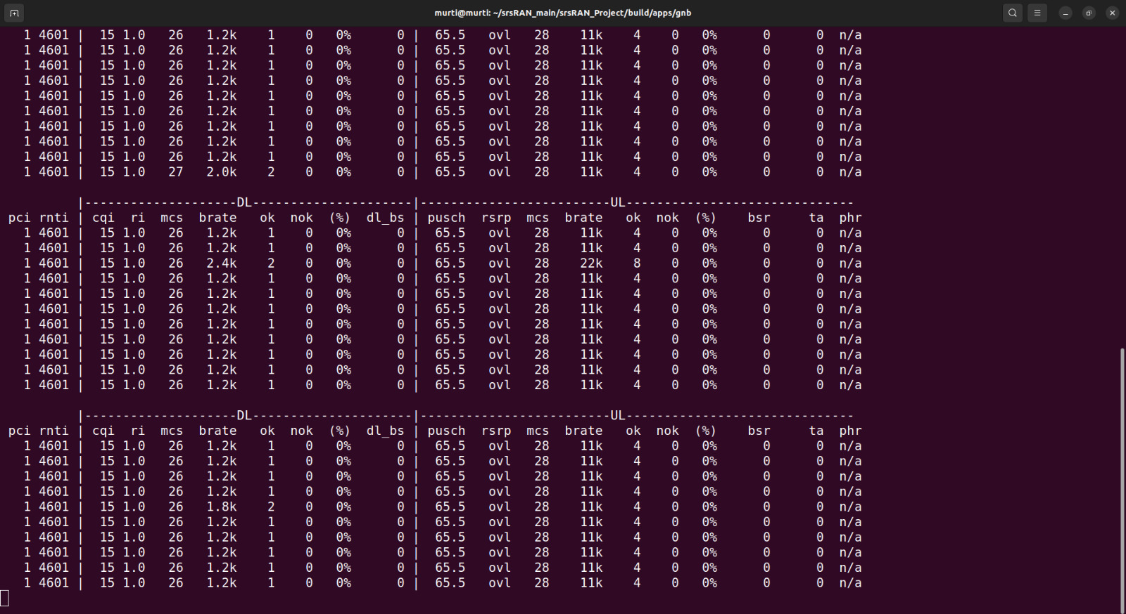
Implementation and Results

Slide 21
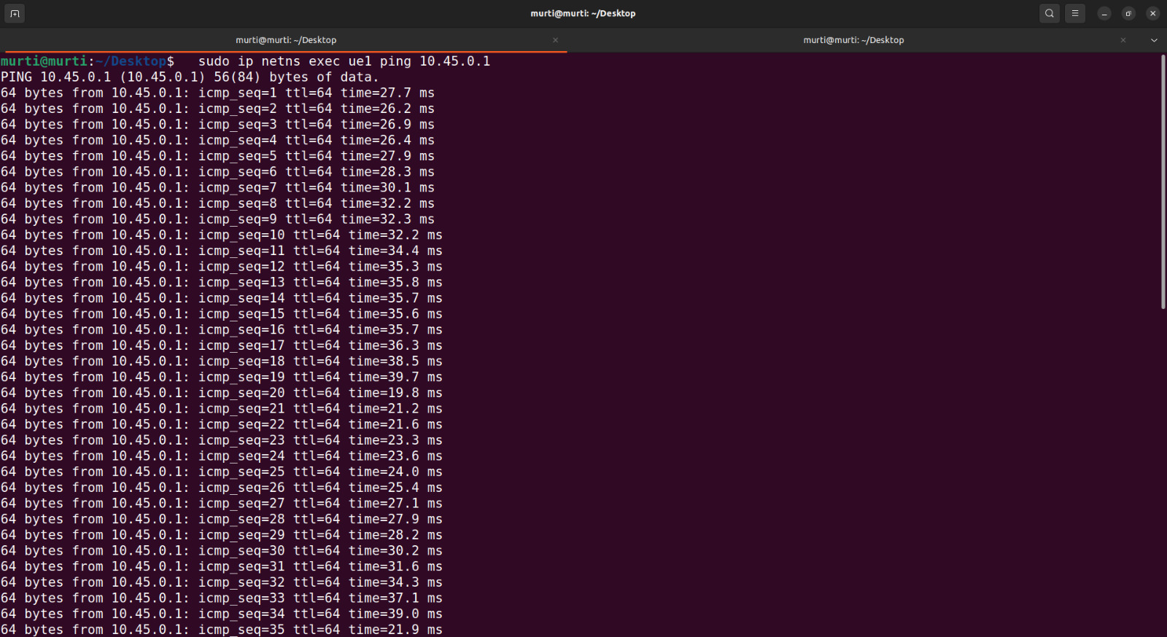
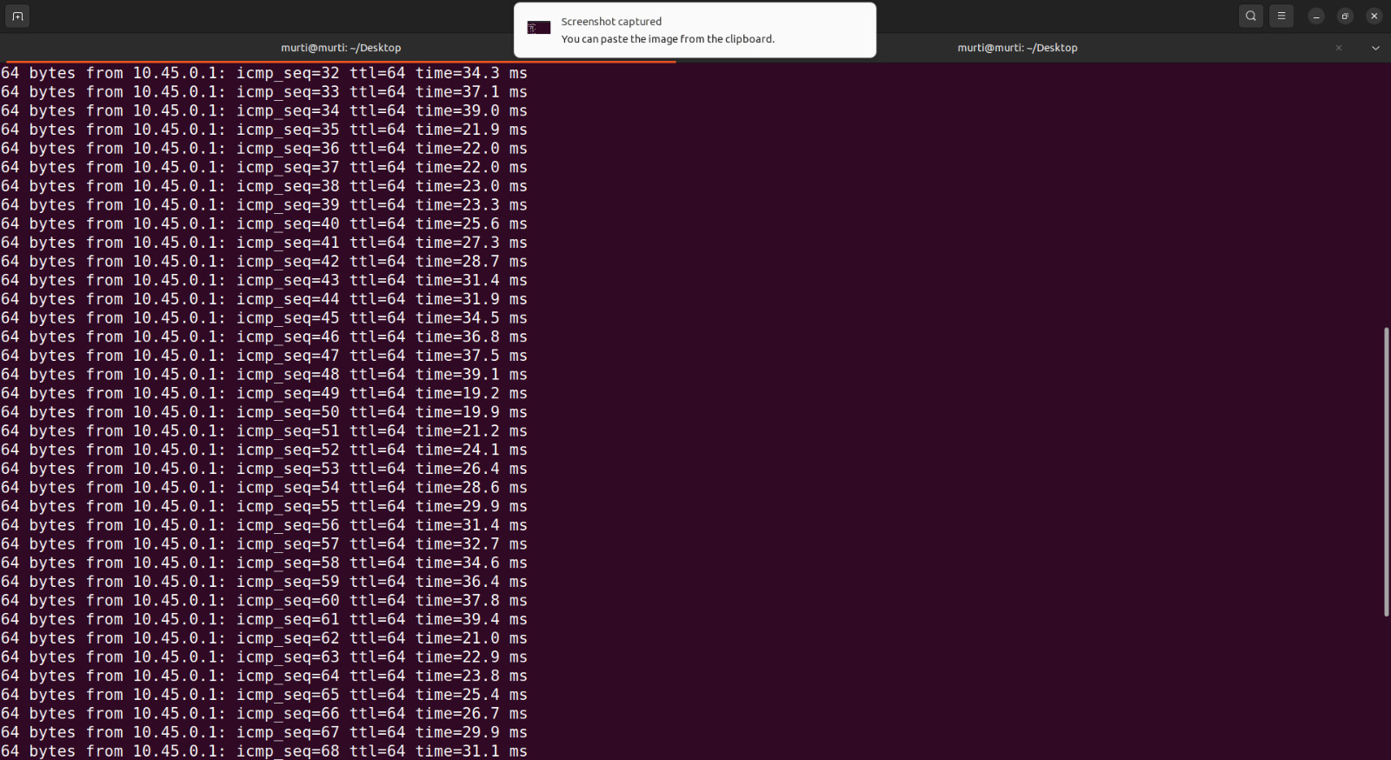
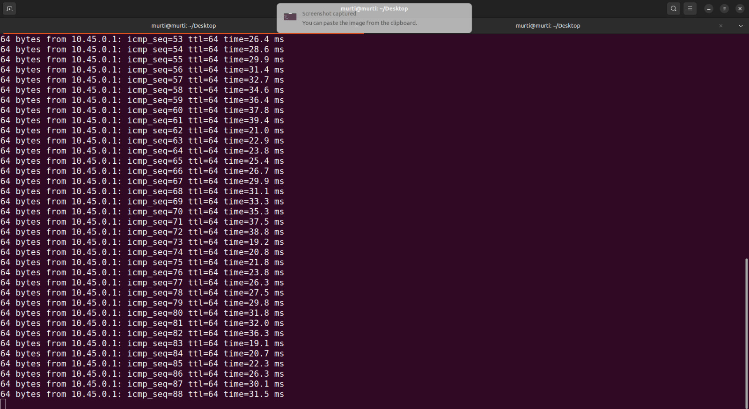
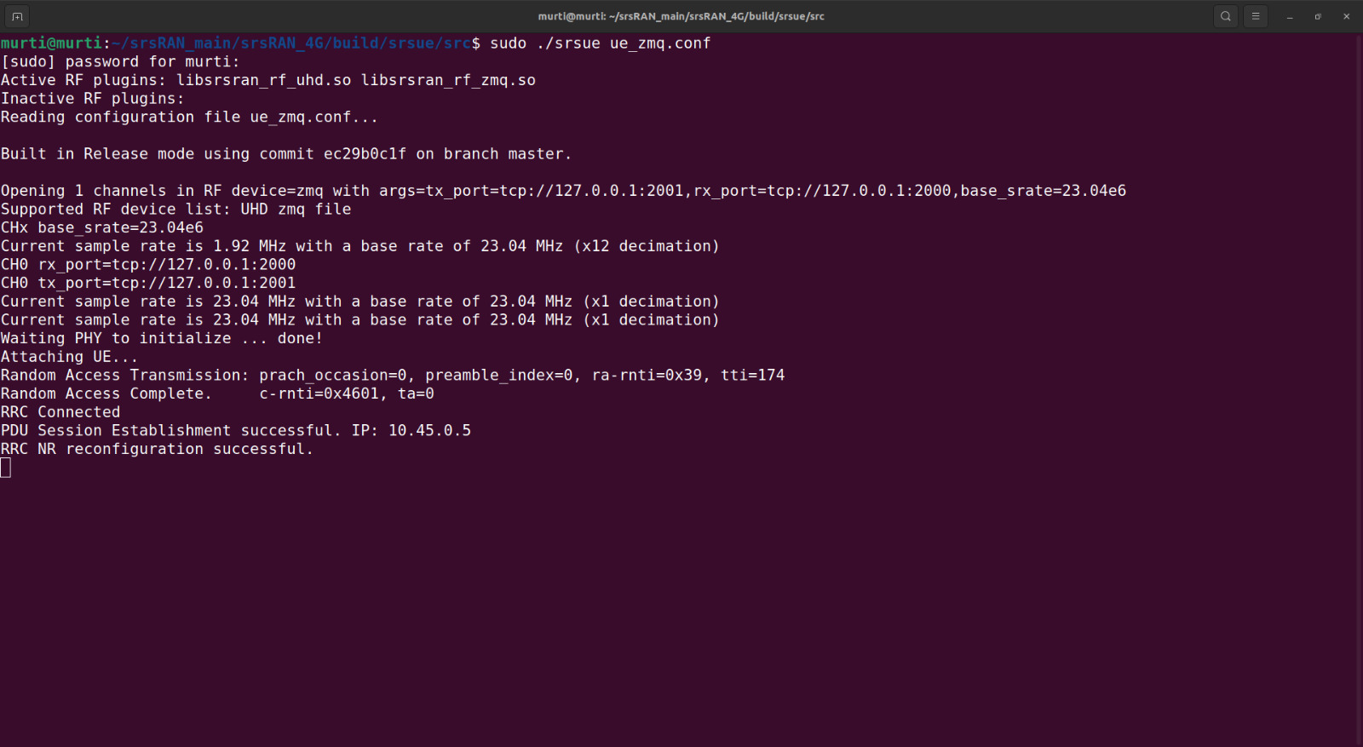
Implementation and Results

Slide 22
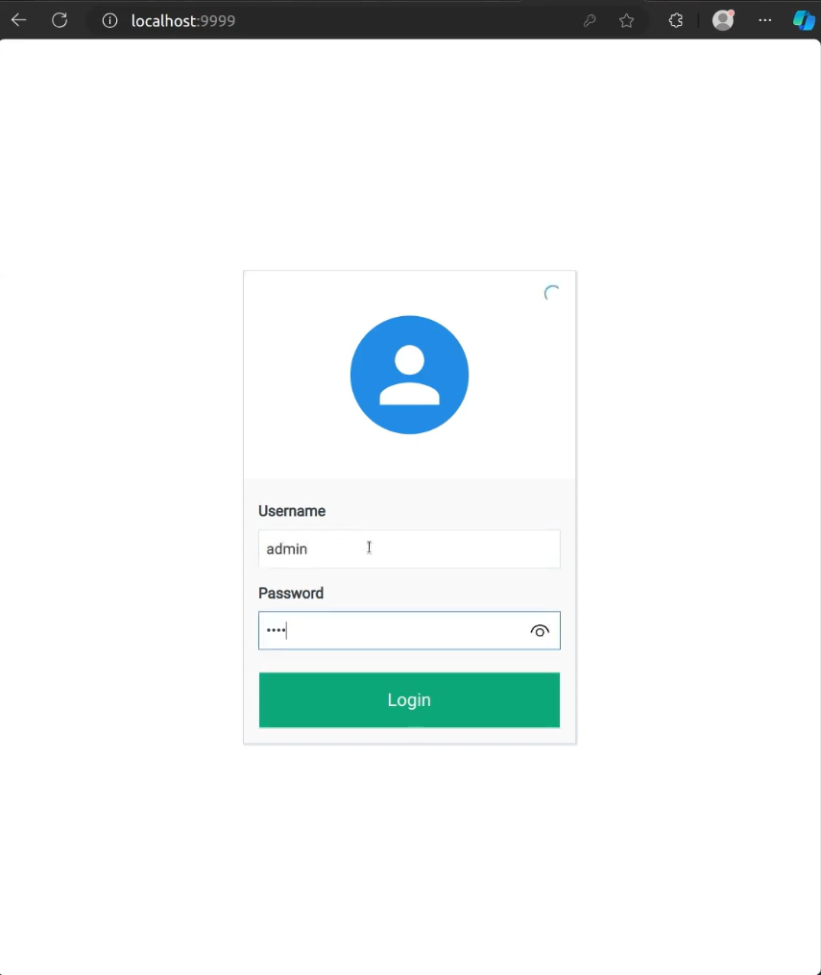
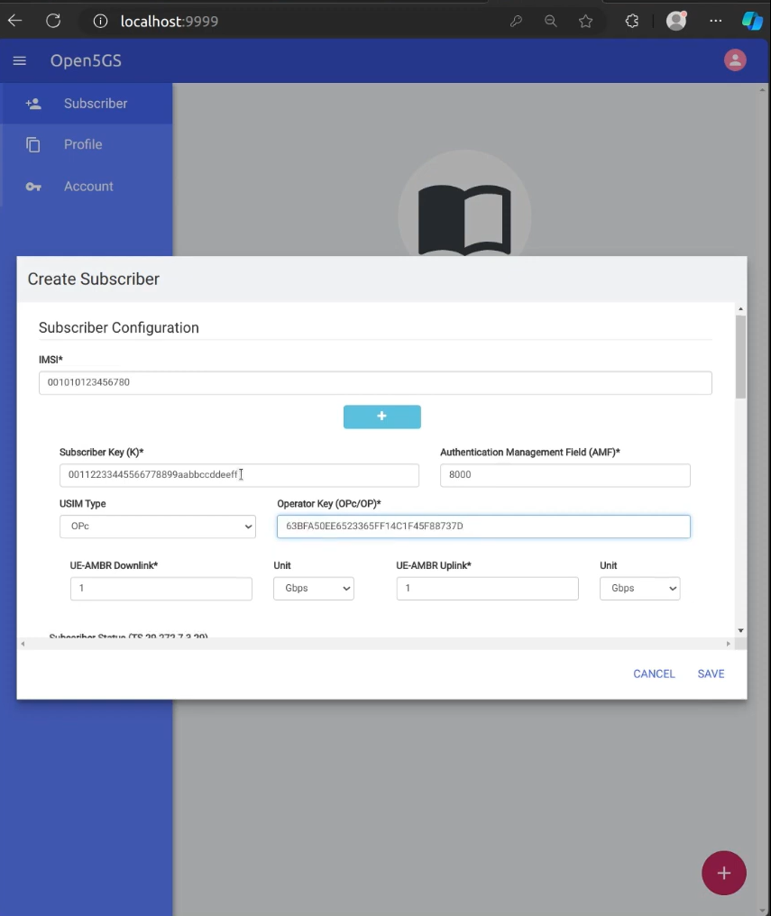
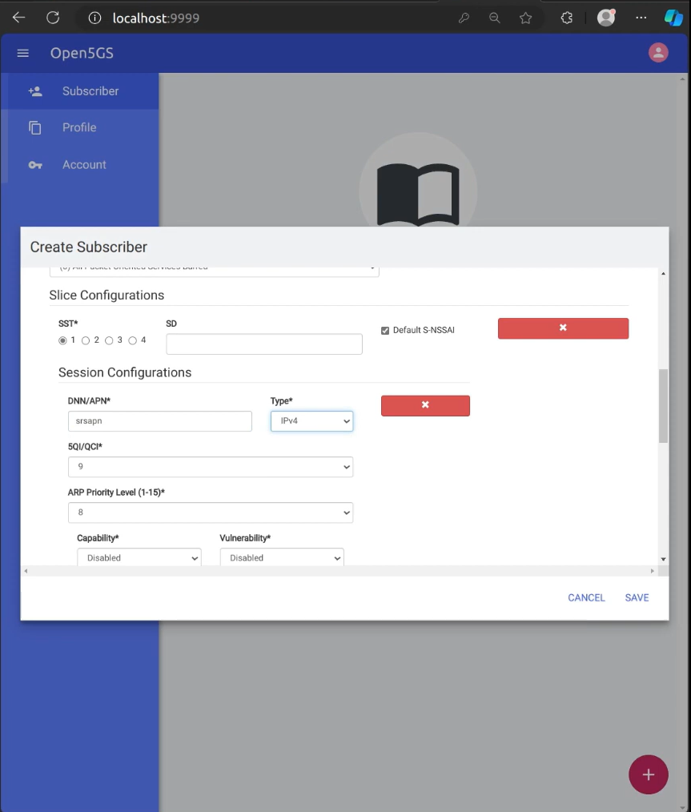
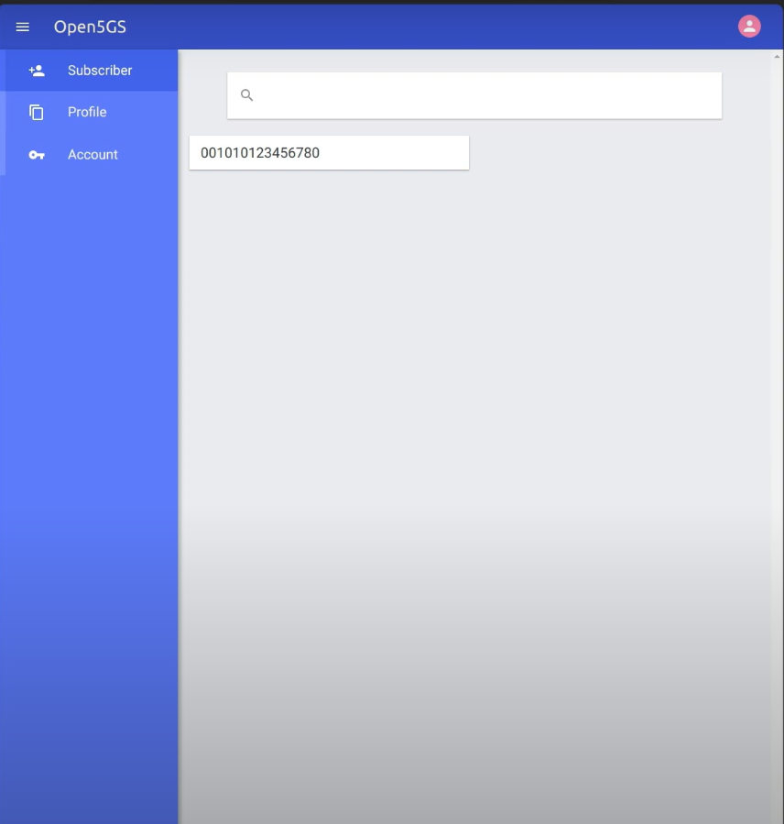
Implementation and Results

Slide 23
Implementation and Results
Objective 2: Zeromq Multiple UE Implementation
sudo apt-get install gnuradio
cd ./srsRAN_Project/docker
docker compose up --build 5gc
cd ./srsRAN_Project/build/apps/gnb
sudo ./gnb -c gnb_zmq.yamlsudo ip netns add ue1
sudo ip netns add ue2
sudo ip netns add ue3
cd ./srsRAN_4G/build/srsue/src
sudo ./srsue ./ue1_zmq.conf
sudo ./srsue ./ue2_zmq.conf
sudo ./srsue ./ue3_zmq.conf
sudo gnuradio-companion ./multi_ue_scenario.grc
sudo sysctl -w net.ipv4.ip_forward=1
sudo iptables -t nat -A POSTROUTING -o <IFNAME> -j MASQUERADE
sudo ip netns exec ue1 ping -i 1 8.8.8.8
route –n
sudo ifconfig ogstun 0.0.0.0 down
ip -o addr show | grep "10.53.1.1“
sudo ip addr add 10.53.1.3/24 dev BRIDGE_NAME

Slide 24
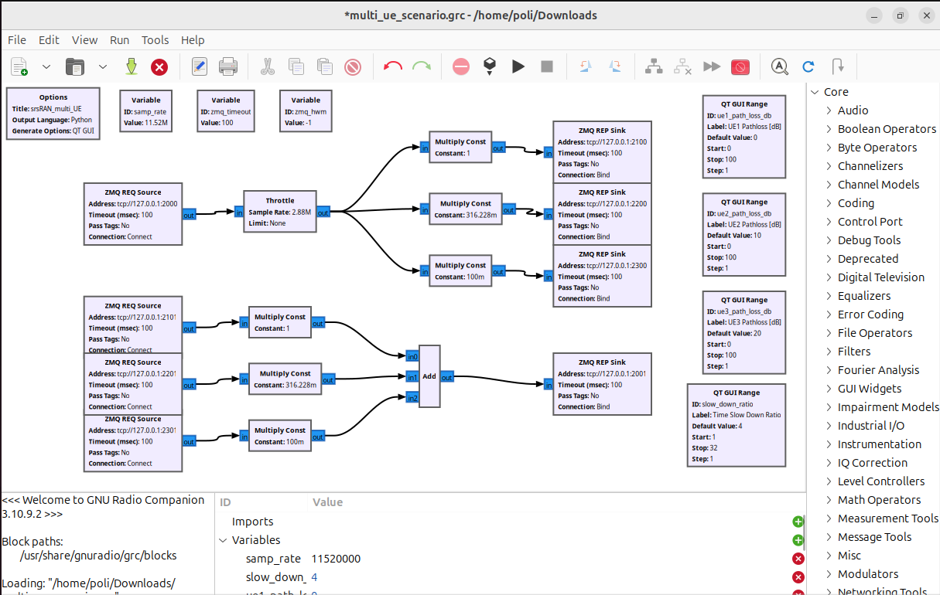
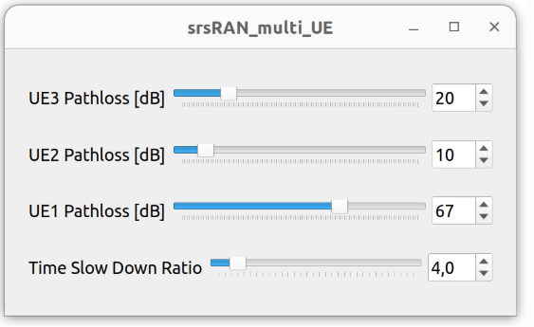
Implementation and Results

Slide 25
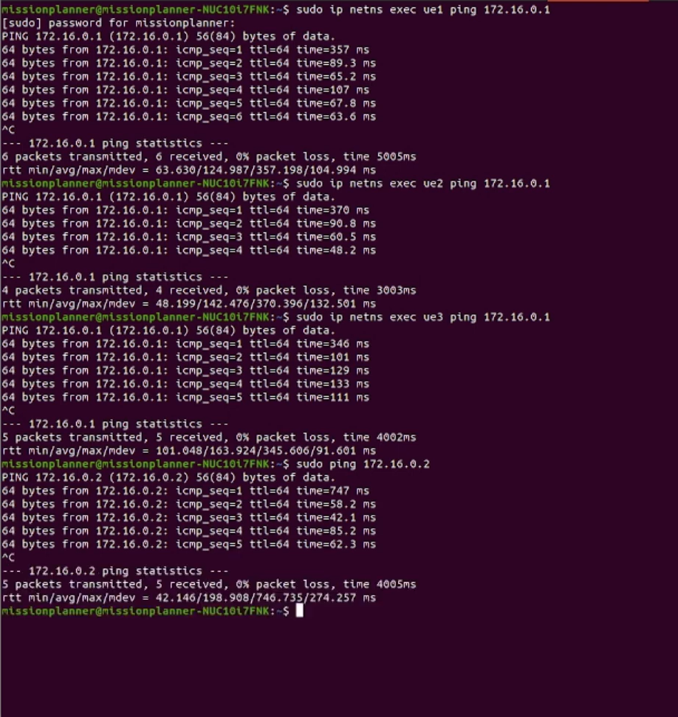
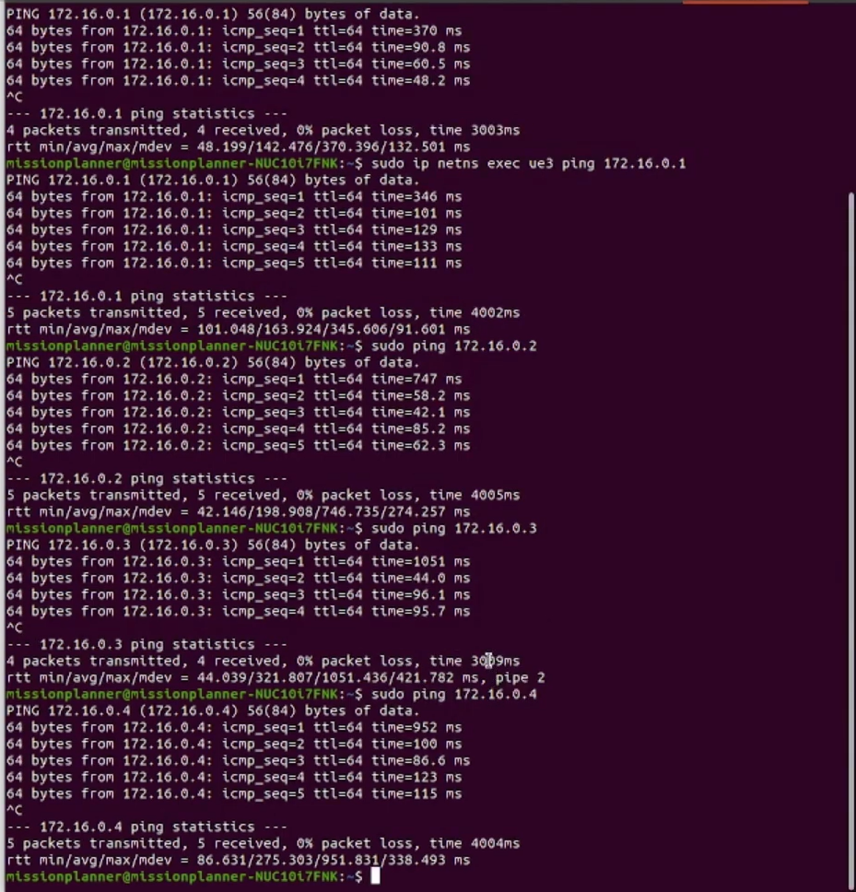
Implementation and Results

Slide 26
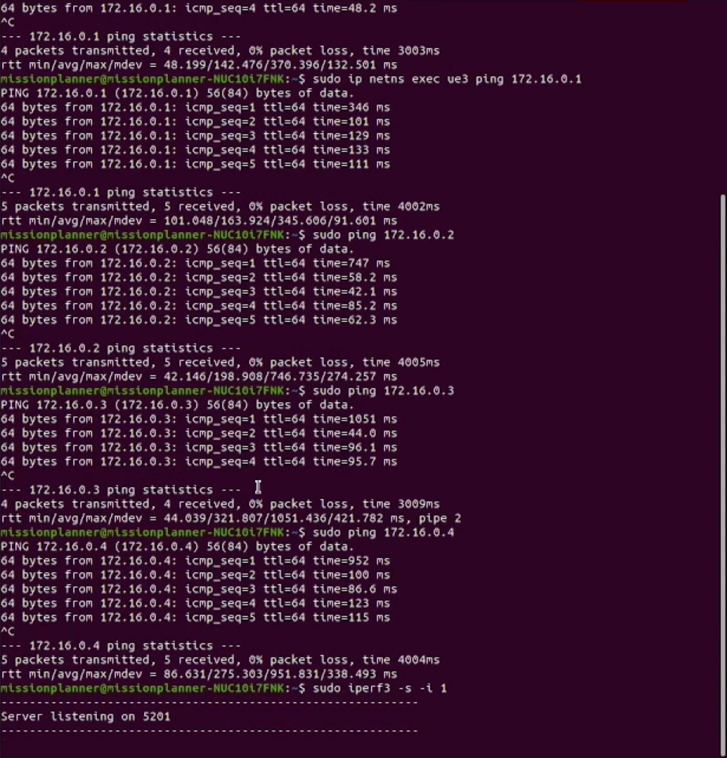
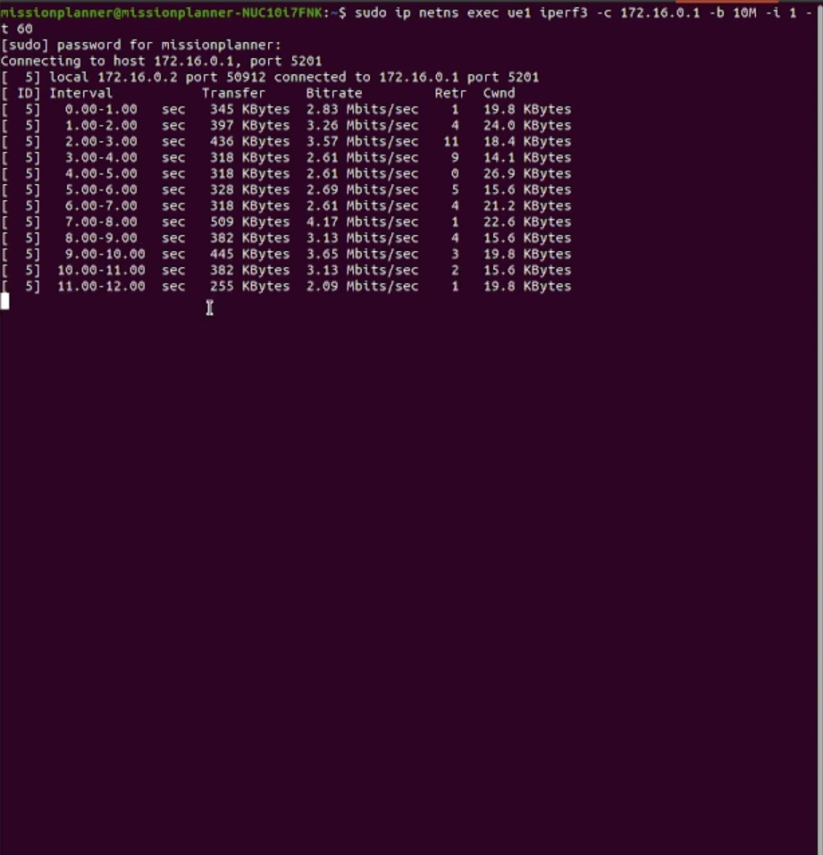
Implementation and Results

Slide 27
Implementation and Results
Objective 3: Grafana Metrics GUI
Ip a ping ip addr ping bind addr sudo nano /etc/open5gs/amf.yaml
Sudo tail –f /var/log/open5gs/amf.log
sudo systemctl restart open5gs-amfd
sudo netstat –sctp –plantu | grep 38412 sudo nano /etc/open5gs/upf.yaml
Sudo systemctl restart open5gs-upfd
Sudo nano /etc/open5gs/nrf.yaml
Sudo systemctl restart open5gs-nrfd.service
Nano gnb_zmq.yaml
Sudo ./gnb –c ./gnb_zmq.yaml
sudo netstat –sctp –plantu | grep 38412
Nano ue_zmq.conf
Sudo ip netns add ue1
Sudo ./srsue ue_zmq.conf
Sudo ip netns exec ue1 ip route add default via 10.45.0.1 tun_srsue
Sudo ip netns exec ue1 route –n
sudo iptables -t nat -A POSTROUTING -o <IFNAME> -j MASQUERADE
Sudo ip netns exec ue1 ping ip addr
Sudo ip netns exec ue1 iperf3 –c ip
Sudo system start influxdb
Influx setup –name MonInfluxdb2 –host http://localhost:8086 –u admin –p rt123456 –o srs –b srsRAN –t monToken –r 0 –f
Nano TokenSRSRAN.txt
Nano script_serveur_metriques_srsran.sh
./script_serveur_metriques_srsran.sh
Sudo systemctl start grafana-server
Sudo ip netns exec ue1 mkfifo /tmp/tampon.fifo sudo ip netns exec ue1 wget https://ip addr/Extrait_The_Social_Network-1080.mp4 –O /tmp/tampon.fifo –bind-address=10.45.0.1 ffplay –I /tmp/tampon.fifo

Slide 28
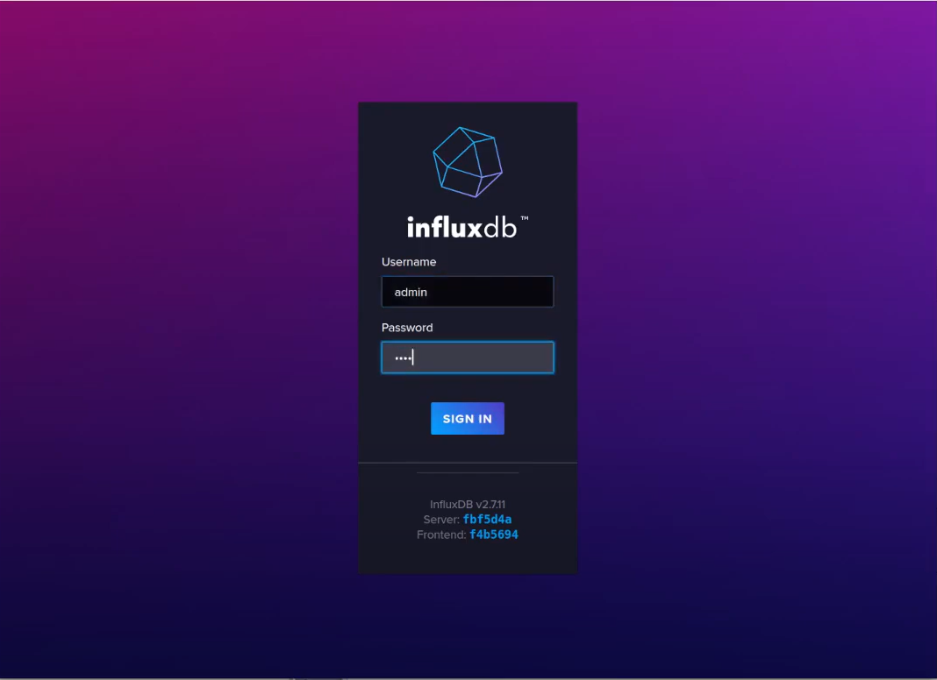
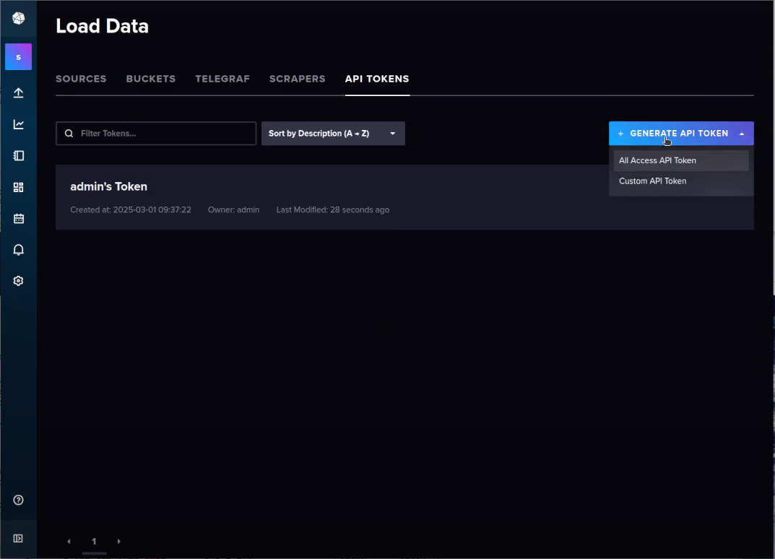
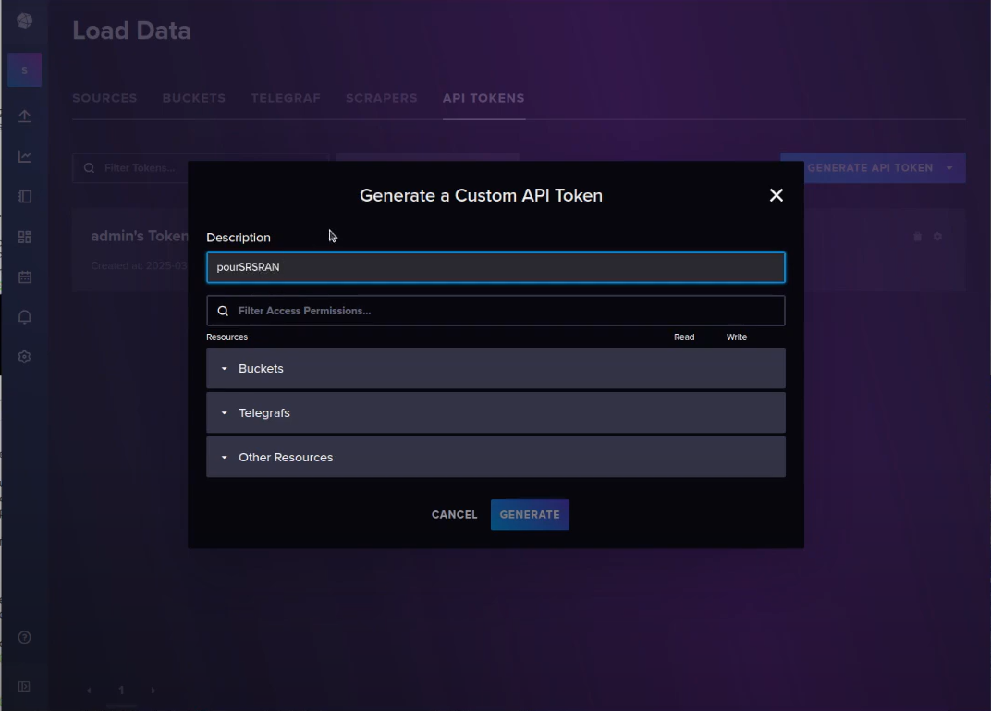
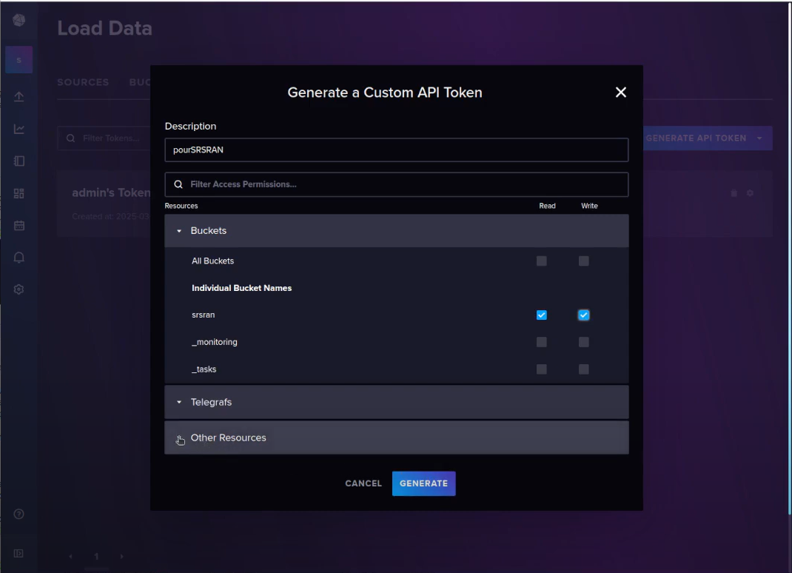
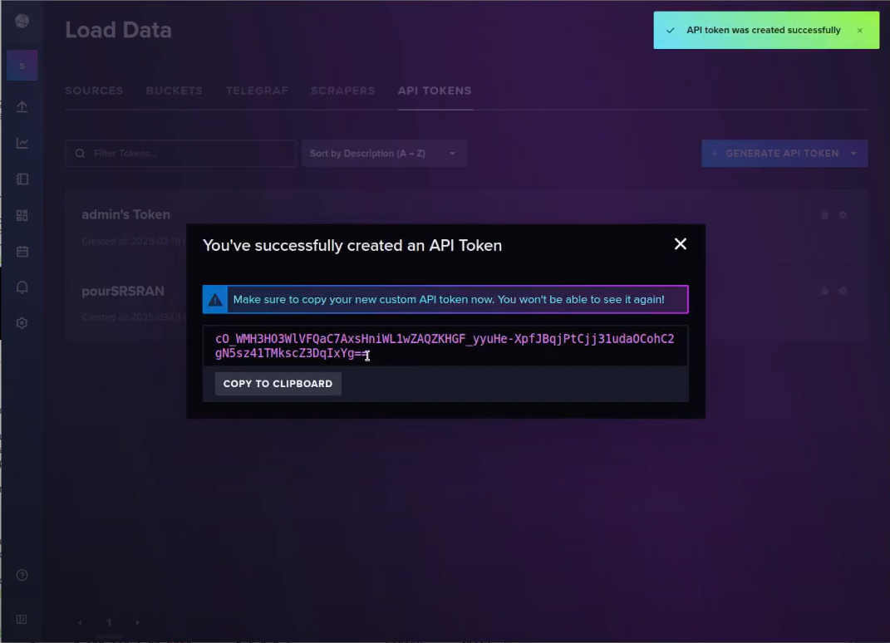
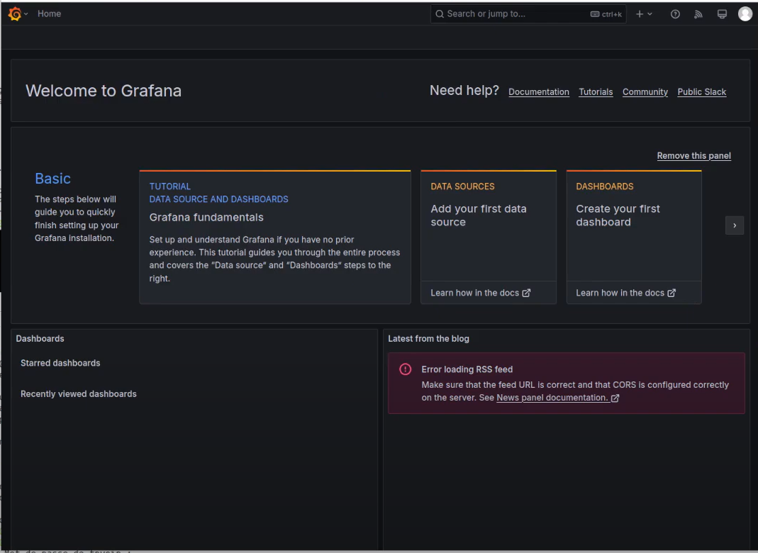
Implementation and Results

Slide 29
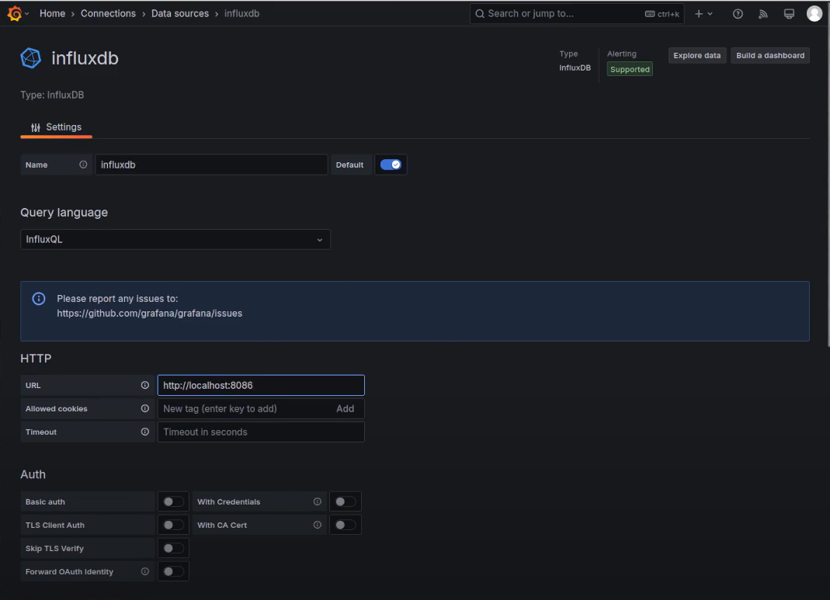
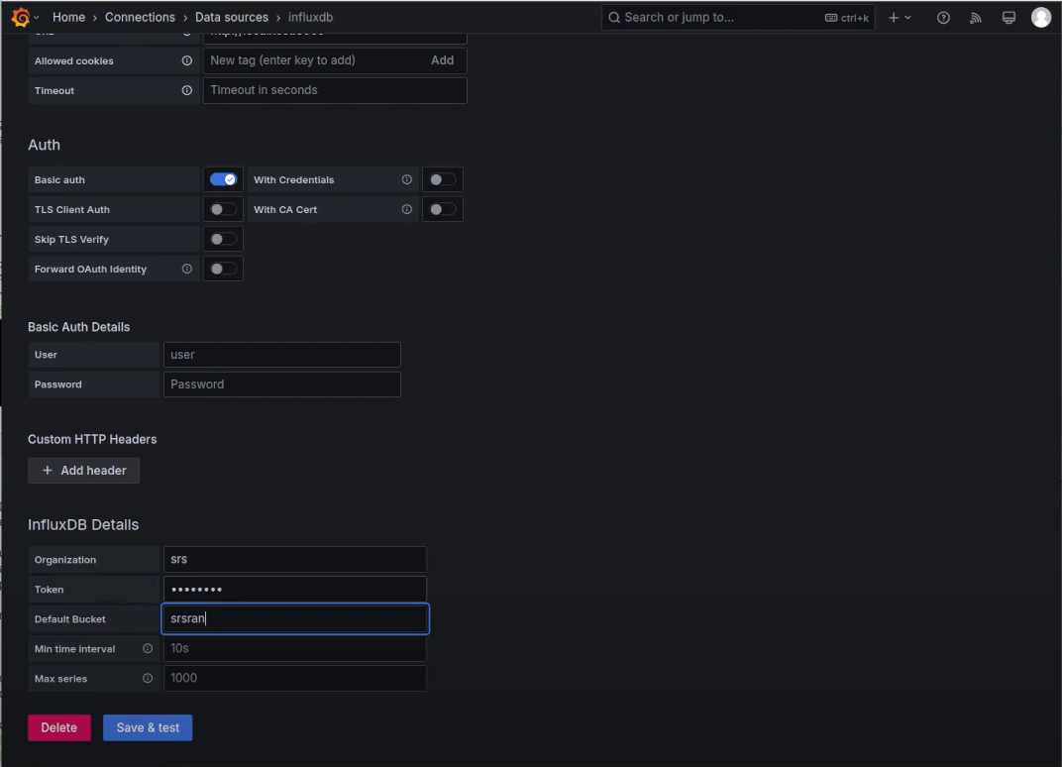
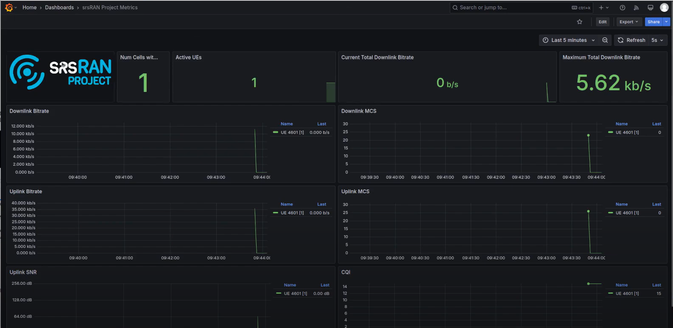
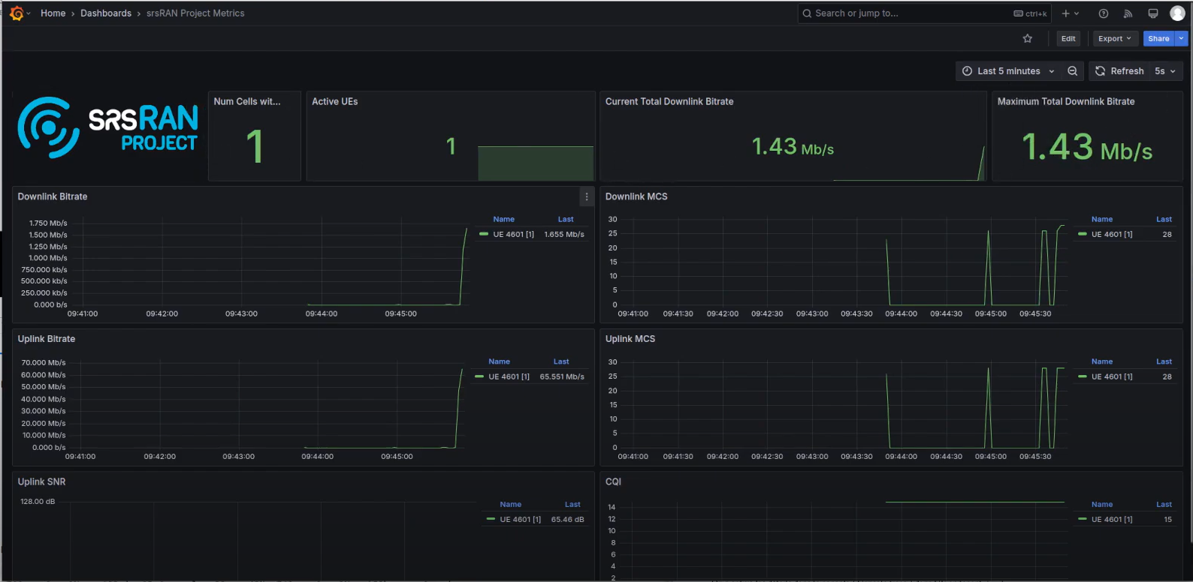
Implementation and Results

Slide 30
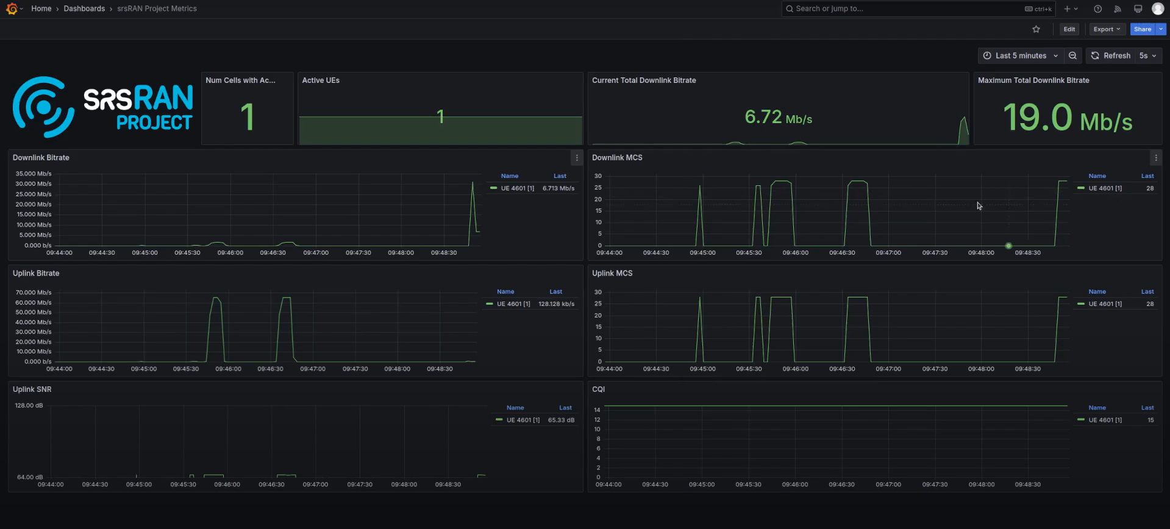
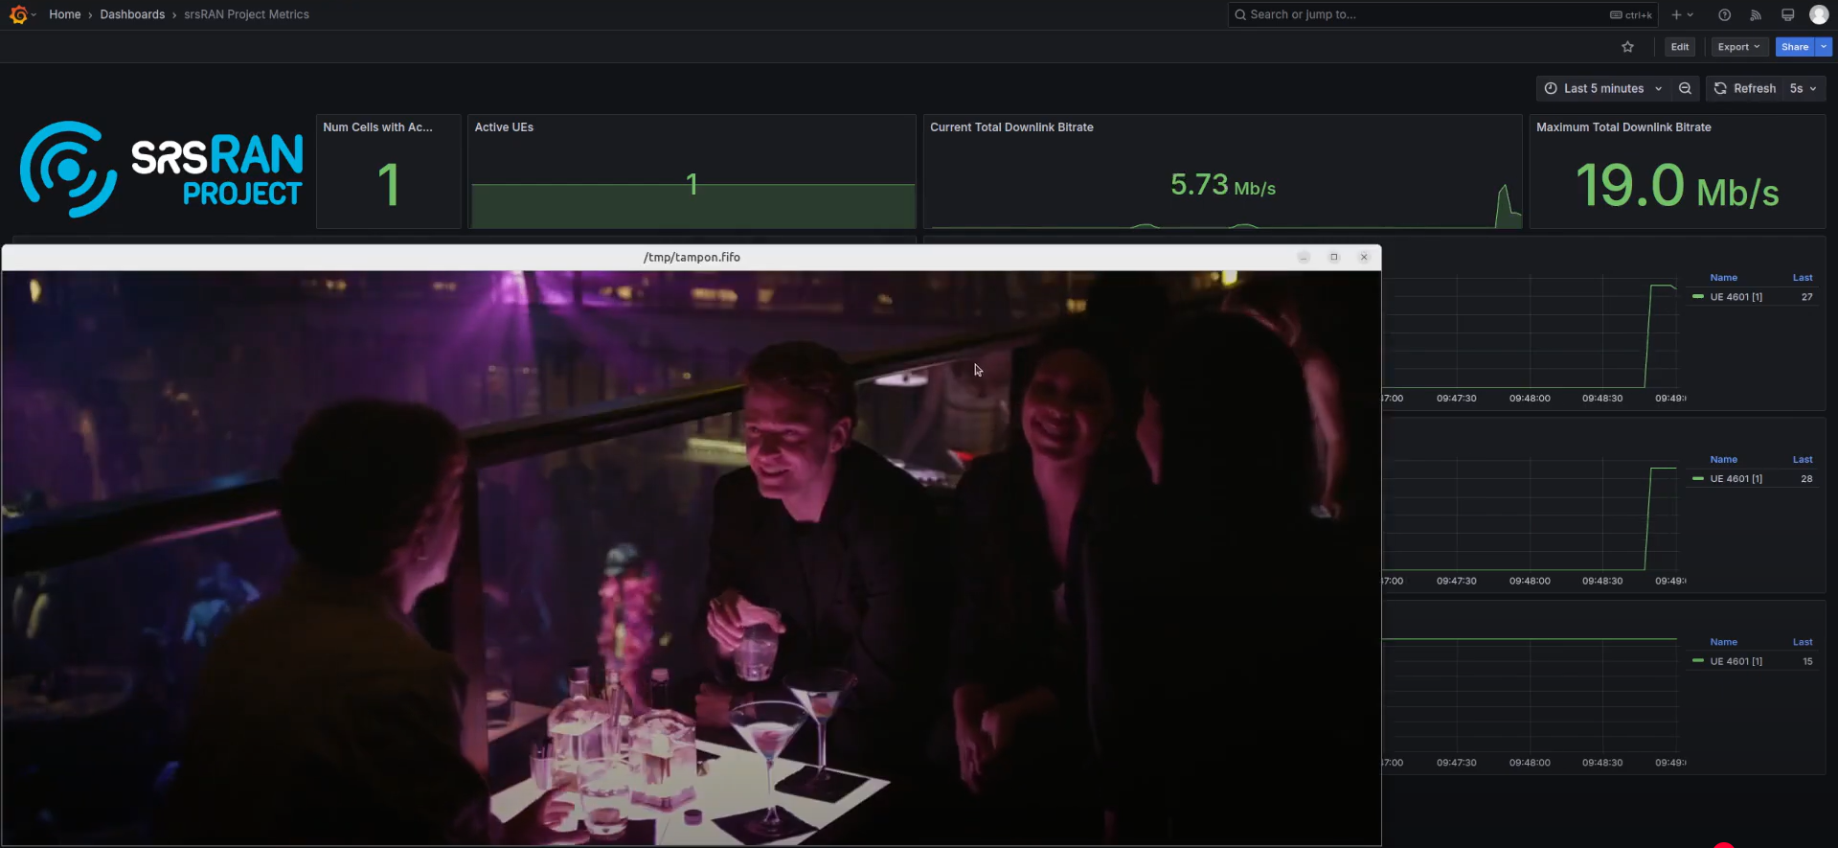
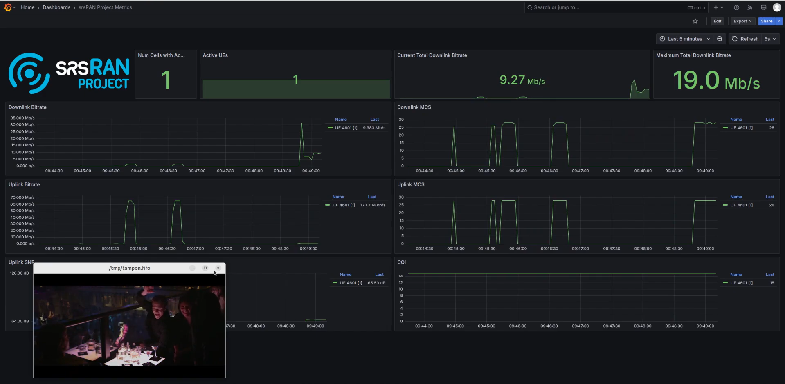
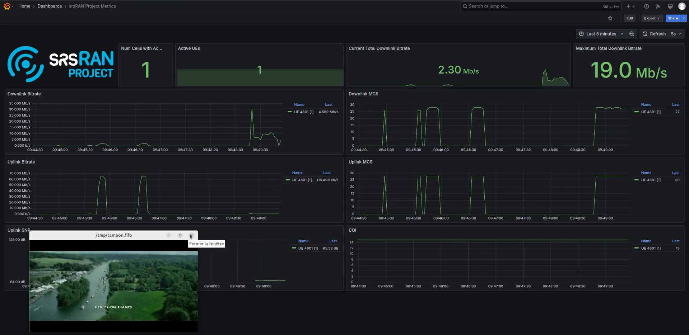
Implementation and Results

Slide 31
Contribution
Team Progress and Movement
Individual Contribution
Key contributions: P.Prudvi Reddy
Conducted debugging and troubleshooting, identifying and resolving CMake errors and other compatibility issues during network setup.
Executed and tested network configurations through the terminal, ensuring smooth deployment and performance.
Performed comprehensive testing to evaluate network performance, measuring throughput, latency, and signal quality for both uplink and downlink.
Assisted in setting up the 5G private network, ensuring proper integration with srsRAN 5G, srsRAN 4G, and OAI.
Key contributions: MC.Mokshith
Researched and gathered necessary resources and dependencies for the project, ensuring compatibility with srsRAN and USRP N321.
Developed and optimized configuration files to establish eNodeB for 4G and prepare for gNodeB setup in 5G.
Assisted in the debugging process, working with team members to resolve errors and improve system stability.
Key contributions: B.Gopal
Contributed to the creation of posters, PowerPoint presentations (PPTs), and project reports, ensuring clear documentation of progress..
Assisted in setting up the Access Point Name (APN) for mobile connectivity within the network.
Helped in debugging various network issues, working alongside the team to troubleshoot and optimize system performance.
Defined project objectives and requirements for establishing a scalable 5G private network using USRP N321, integrating srsRAN 5G, srsRAN 4G, and OAI.
Conducted research on srsRAN and OAI architectures, focusing on seamless hardware and protocol integration.
Set up a Linux-based environment and successfully deployed eNodeB for 4G, while the 5G gNodeB setup is still in progress.
Implemented ZeroMQ-based communication for efficient data exchange between network components.
Configured APN and programmable SIMs to enable connectivity for single and multiple UEs in the 4G setup.
Performed initial testing on the 4G network, analyzing uplink, downlink, and SIM authentication.
Integrated Grafana for real-time performance monitoring, with ongoing efforts to enhance visualization and analysis.
Currently working on establishing the 5G network, optimizing performance, and implementing security features before final deployment and testing.
31

Slide 32
Conclusion & Future Work
Summary and Conclusion
Future Work
Designed and deployed a 5G private network using USRP N321, integrating srsRAN 5G, srsRAN 4G, and OAI to ensure a scalable and flexible architecture.
Implemented ZeroMQ to enable efficient and seamless data exchange between network components, optimizing communication performance.
Evaluated network performance with single and multiple UEs, ensuring robust connectivity, scalability, and stable data transmission.
Integrated Grafana for real-time monitoring, analyzing key performance metrics such as throughput, latency, and reliability to optimize network efficiency.
Ongoing efforts focus on further optimizations, security enhancements, and final deployment testing to refine network stability and performance.
Implement srsRAN gNB with DPDK, leveraging Data Plane Development Kit to enhance packet processing efficiency, reduce latency, and improve overall network performance.
Optimize srsRAN gNB Performance Tuning, focusing on fine-tuning network parameters to maximize throughput, reliability, and scalability for high-performance applications.
Explore srsRAN gNB on Kubernetes, enabling containerized deployment for enhanced scalability, flexibility, and resource management in cloud-native environments.
32

Slide 33
THANK YOU
Have a Great Day !

